Slide 1

Water Health Partnership
Conference 2024

Slide 2
Welcome
Sharon Evans
Director of Quality, Policy and Compliance, Dŵr Cymru Welsh Water
Chair of Water Health Partnership Steering Group
Chair of morning session

Slide 3

Housekeeping
No fire alarm tests – evacuation arrangements
Facilities
Mobile Phones
Timekeeping

Slide 4
Mission Statement of the WHP:
Protecting and enhancing public health by working together to deliver consistent understanding and management of water quality issues and to supply safe & resilient water services.

Slide 5
Aims of the WHP
Facilitate improved communication and data sharing between public health practitioners
Delivering against the objectives of the Wellbeing of Future Generations Act 2015
Provision of consistent communication and messaging on public health issues within scope
Initiate events, training, CPD and raise awareness of health issues related to public and private water services and associated topics of interest
Undertake specific supporting activities through the work of multi-agency working groups

Slide 6
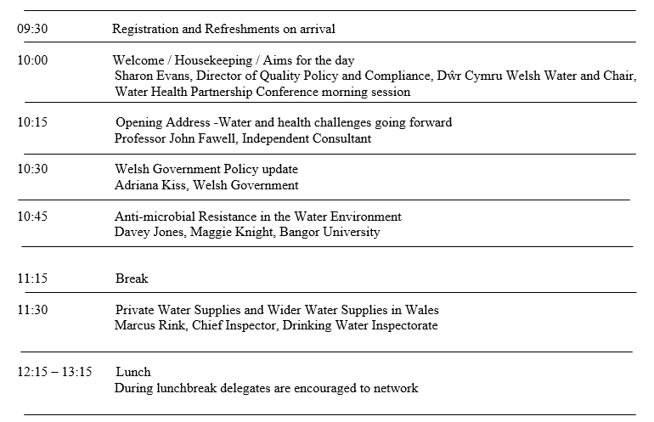
Agenda

Slide 7
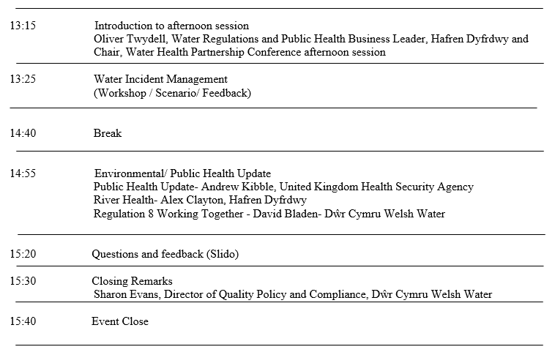
Agenda

Slide 8
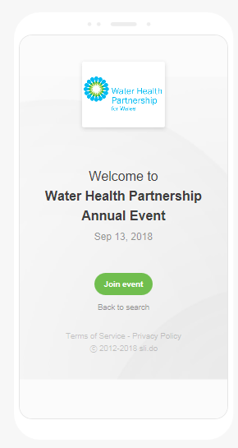

Slido Questions/ Feedback
How to join the event
Open a browser on any laptop, tablet or smartphone
Go to slido.com
Enter the event code #WHP2024
Or
Scan the QR code

Slide 9

Rules for the day
Interact
Engage
Enjoy

Slide 10
Water and Health Challenges Going forward.
Professor John Fawell
Visiting professor Cranfield University Water Science Institute

Slide 11
WE ARE NOT JUST A COMMODITY
Drinking Water and Sanitation
An Essential Public Health Service
A core part of a functioning society

Slide 12
Ignorance Media Politicians
Conflict
CLIMATE CHANGE
Water Quantity Water Quality
Infrastructure “Emerging” Contaminants

Slide 13
High Income Countries
Ageing Populations
Ageing infrastructure
Drinking Water and Sanitation Are Two Sides of The Same Coin

Slide 14
Increasing Challenges
Restrictions on Water Resources,
reducing demand without affecting hygiene and hydration.
climate change and increasing uncertainty.
too much and too little - building protection and resilience.
Water quality challenges and demands for pristine bathing water.
  The problems are not just on the water company, other contributors are important.
  Pathogens remain a threat. Will the future change the risks and the threats?
  Regrowth and growth in distribution and plumbing, Legionella, Pseudomonas, Mycobacteria.
  Viruses and “new” epidemics
  The impact of climate change and changes in water quality on treatment efficiency.

Slide 15
Chemicals
Micropollutants from various sources.
  PFAS, Endocrine disruptors, pharmaceuticals, personal care products.
  Prevention and preventing their entry into water sources.
  This has implications for wastewater treatment.
  Sensible standards that are not excessively precautionary.
  All of this against a background requirement to reduce carbon footprint.
  Important not to create mutually exclusive requirements.

Slide 16
We will need long-term planning and innovation.
We have good people and they need the encouragement to cooperate and work together to achieve sustainable and robust solutions.
Unfortunately this takes time and politicians and the media generally do not do long-term.
We will need a stable policy platform.

Slide 17
Welsh Government Policy Update
Water Health Partnership Annual Conference
25 September 2024
Dr Adriana Kiss
Senior Water Policy Advisor

Slide 18
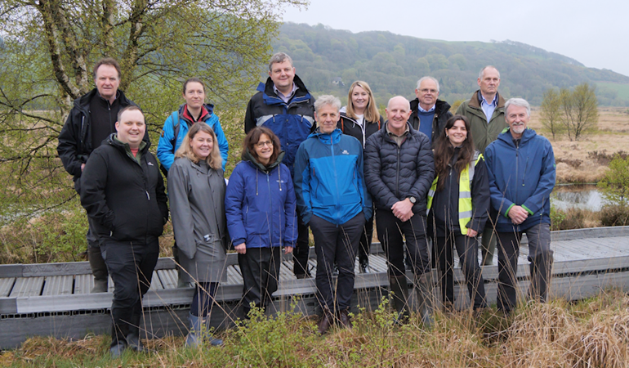
With the reality of the climate crisis, the risk to our water sector is growing. The pressures on water supplies and on infrastructure are unprecedented, and the importance of building resilience to climate change simply cannot be overstated. It will take all of us—all of us—working together to not only address today’s challenges, but also to prepare us for those to come. So, whilst there is a lot done, there is also a lot left to do.
Oral Statement on Water Quality by Huw Irranca Davies MS, Deputy First Minister and Cabinet Secretary for Climate Change, Senedd 17 September 2024
Deputy First Minister and Cabinet Secretary, Huw Irranca-Davies MS, during a visit to the Teifi Catchment with Natural Resources Wales

Slide 19
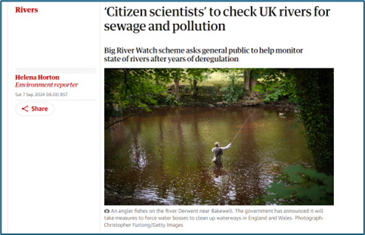
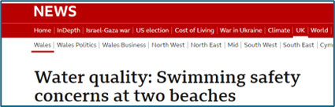

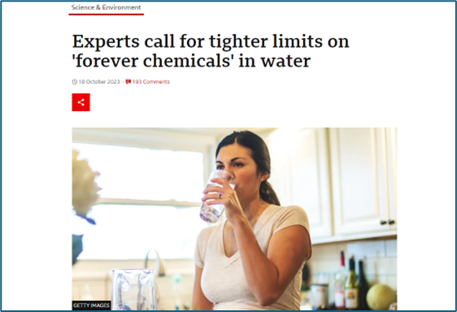
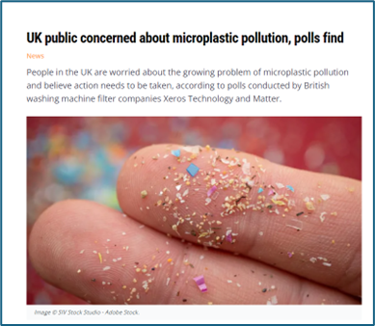
Ongoing Challenges and Pressures
Continued high interest in inland and coastal water quality by the media, the public and the Senedd.
Pollution in our waterways comes from a wide range of sources, including agriculture and rural land use, urban and industrial runoff, sewage pollution and pollution from abandoned mines.
Climate change presents a risk to both water supply and water quality. Private water supplies are particularly vulnerable.
Addressing legacy pollutants such as mercury and PCBs, and lead in domestic plumbing is a continued challenge.
It is important to identify and consider emerging contaminants such as PFAS, pharmaceuticals and microplastics

Slide 20

Key Headlines
There have been 5 Special Areas of Conservation (SAC) Rivers Summits in Wales with the last one taking place in July at the Royal Welsh Show. The Summits focus on addressing phosphorus pollution.
The Welsh Government has made a £40 million multi-year funding available to NRW to support water quality improvement, including the remediation of polluting abandoned metal mines.
In May, the Deputy First Minister introduced a new partnership between Water Safety Wales and RoSPA to promote water safety across Wales, backed by funding from the Welsh Government.
Funding has been provided to Cardiff University on developing a water quality monitoring pilot for a shared platform.
The Welsh Government has funded Bangor University to gain better understanding of the spread of AMR in the water environment.
The Emerging Threats to Water Quality Working Group has been focusing on diazinon, pharmaceuticals and PFAS.
A SuDS workplan has been approved by the Deputy First Minister to further improve on the globally leading Welsh statutory SuDS legislation for new development.
Excellent drinking water quality (99.96% compliance with statutory standards for mains supply)
40% of waterbodies at good or better ecological status, with 44% of rivers achieving this classification under the Water Framework Directive Regulations
93% of waterbodies meeting the requirement for chemical standards
There are 110 designated bathing waters in Wales. Most are coastal.
The Warren is the first river to be designated as a bathing water in Wales.
98% of designated bathing waters across Wales met stringent bathing water quality standards, with 80 of our bathing waters achieving the highest classification of ‘excellent’ in 2023.
61% of Special Areas of Conservation (SAC) are failing Phosphorus standards

Slide 21
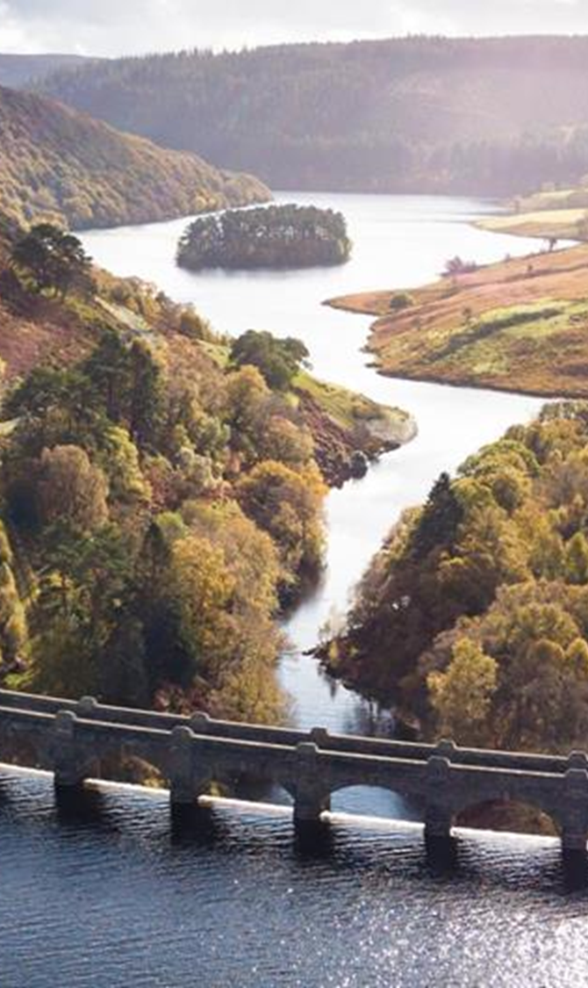
The Water (Special Measures) Bill
Introduced by the UK Government on 4 September 2024 to strengthen the regulation of water companies and support the longer-term work of cleaning up rivers, lakes and seas.
The Bill was developed in partnership between the UK and the Welsh Governments.
The Deputy First Minister and Cabinet Secretary for Climate Change and Rural Affairs has agreed to extend the majority of the provisions of the Bill to Wales.
The Bill has been developed at pace. The Welsh Government will continue to scrutinise the proposed measures and consider the potential impacts for Wales throughout the progress of the Bill in Parliament.
The UK Government has announced its intention to review the water sector regulatory system which will result in further legislation.
The scope of the review has not been announced yet.

Slide 22


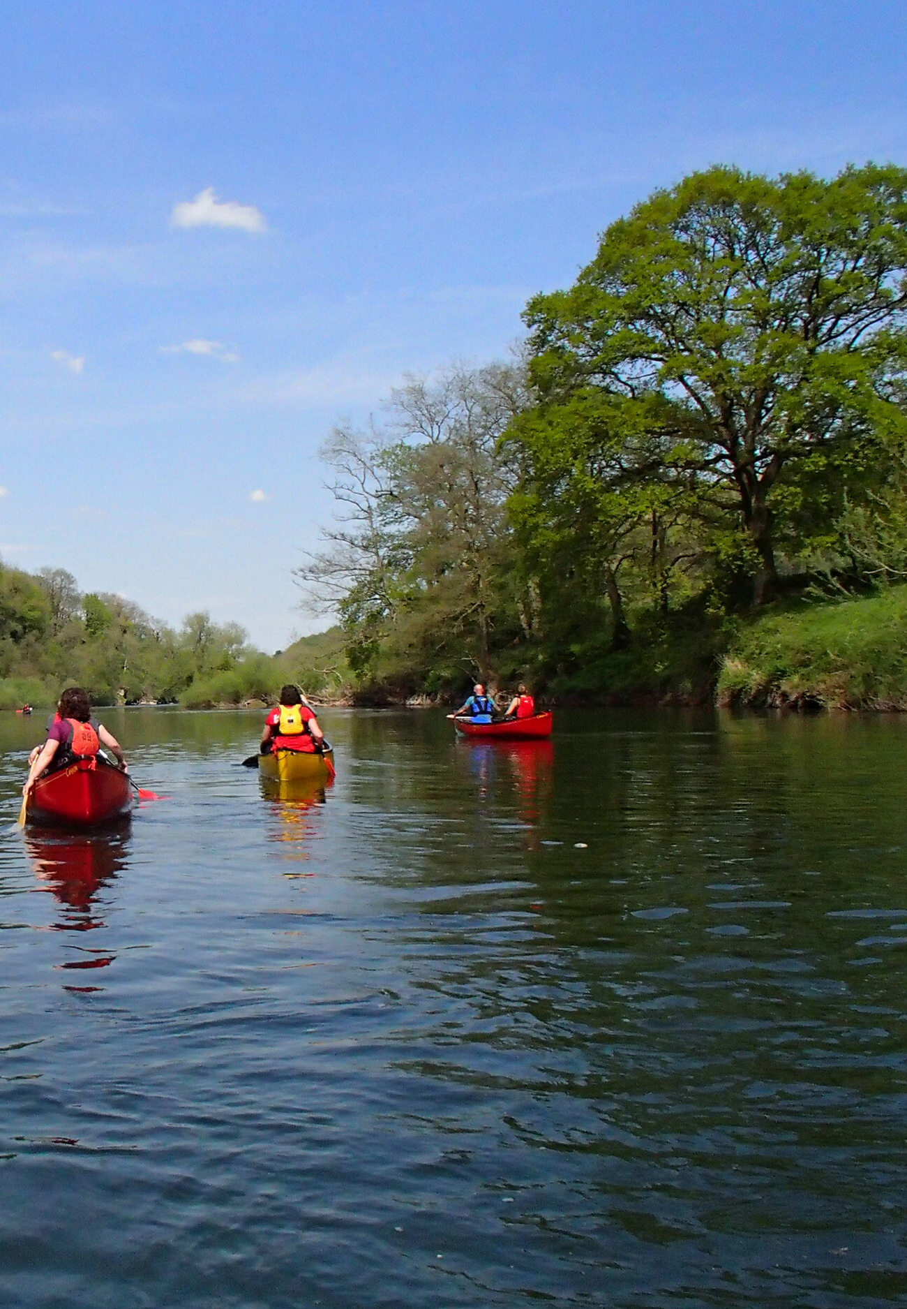
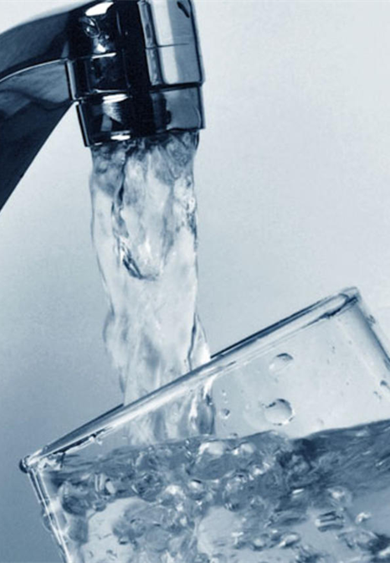

Water Policy - Looking Ahead
Completion of PR24 planning process
Management of the SAC Rivers Summits
Proposed bathing waters reform
Supporting the development and passing of the UK Water Bills
Commitment under the AMR National Action Plan 2024-2029
Review of the drinking water quality standards
Review of the implementation of the Water Framework Directive in Wales
Delivering the SuDS work plan
Emerging contaminants research – PhD placement programme
Continued collaboration with key stakeholders and stakeholder groups such as the Water Health Partnership

Slide 23



Slide 24
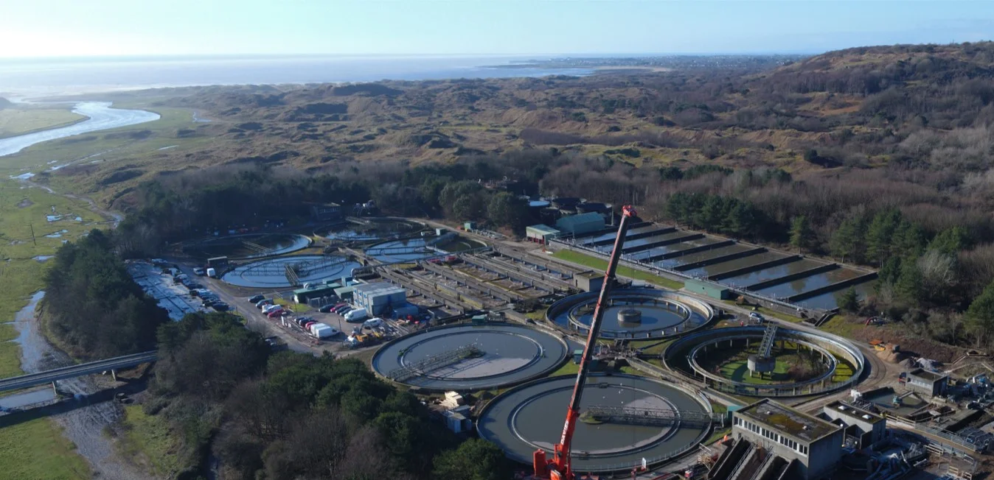


Nationwide survey of the abundance and diversity
of antimicrobial resistance genes in wastewater and environmental samples across Wales
Margaret Knight, Kata Farkas and Davey Jones

Slide 25



AMR
A growing threat to human health
1.27m
deaths
In 2019
Influenza
AMR
Health burden
4.95m
associated
deaths
TB
HIV/AIDS
Acinetobacter spp.
53%
€1.5b
annual cost in Europe
K. pneumoniae
47%
Increase in attributable deaths 2016-2020

Slide 26



Wastewater: A key link in the One Health framework
Source and spread
A pathway for AMR from human excretions into the environment
Exposure risk
Contaminated water exposes humans and animals to AMR
Surveillance opportunity
Wastewater can be used to study population trends in AMR
Environmental health
ONE HEALTH
Animal health
Human health

Slide 27
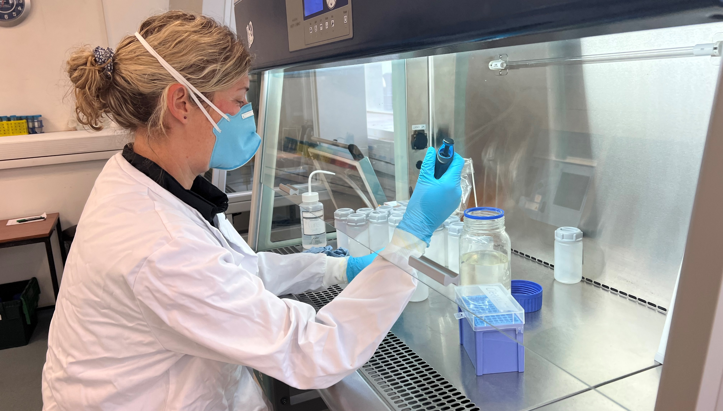
We studied AMR along the wastewater pathway
Influent wastewater
Effluent wastewater
Rivers and estuaries

Slide 28
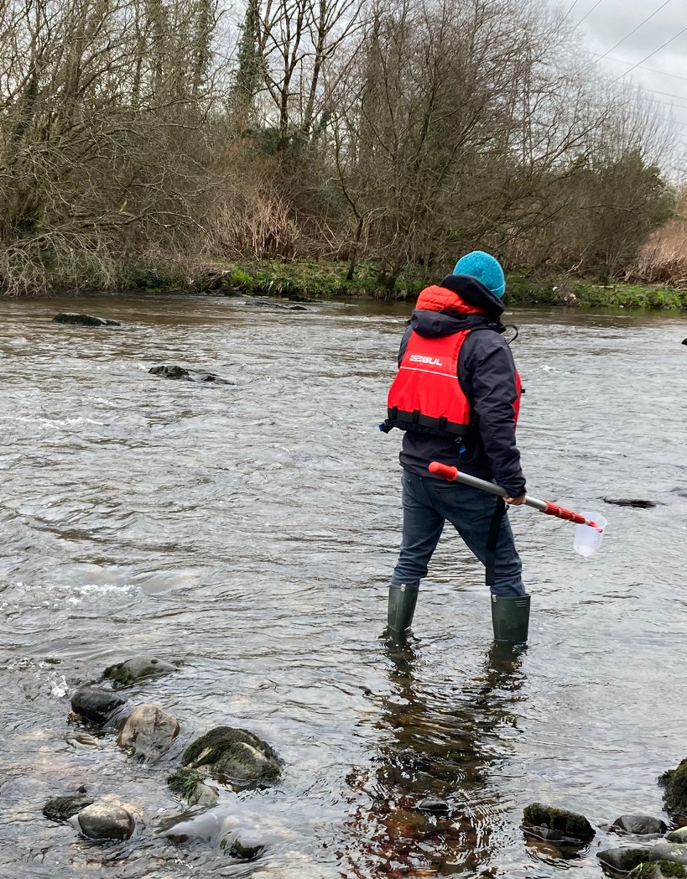
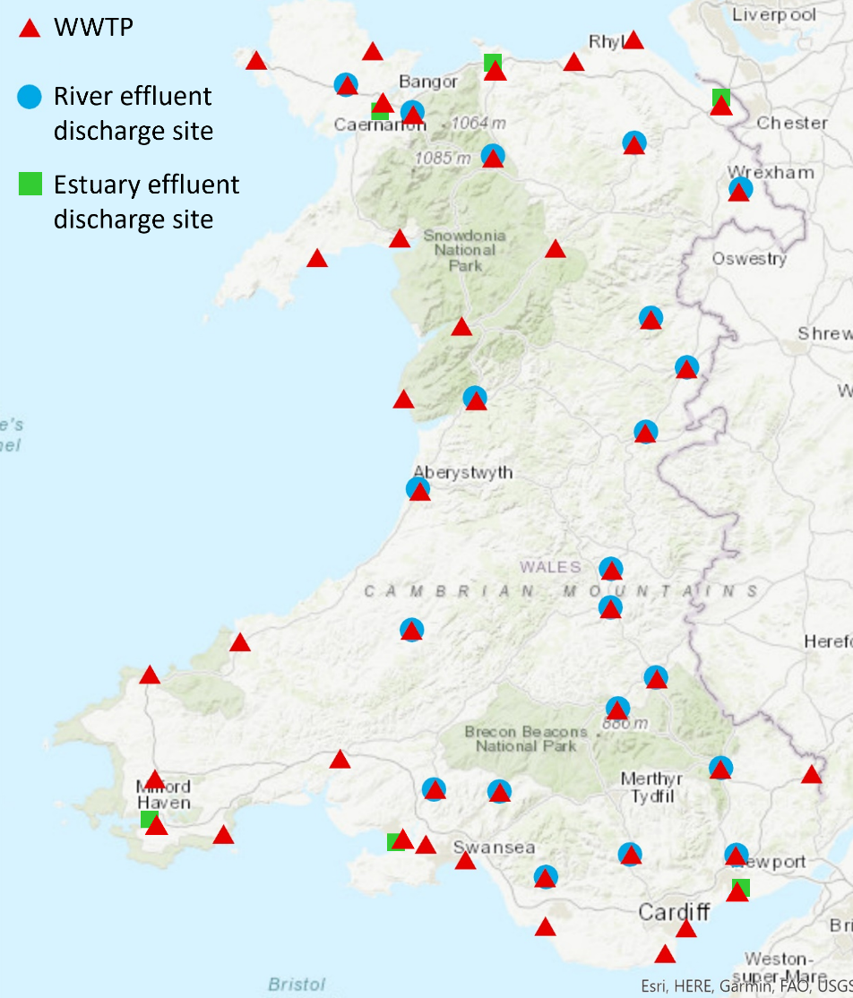
Sampling and analysis
47 WWTPs
20 Rivers
6 Estuaries
5 Beaches
168 total samples
DNA extraction
Analysis of 73 ARGs

Slide 29
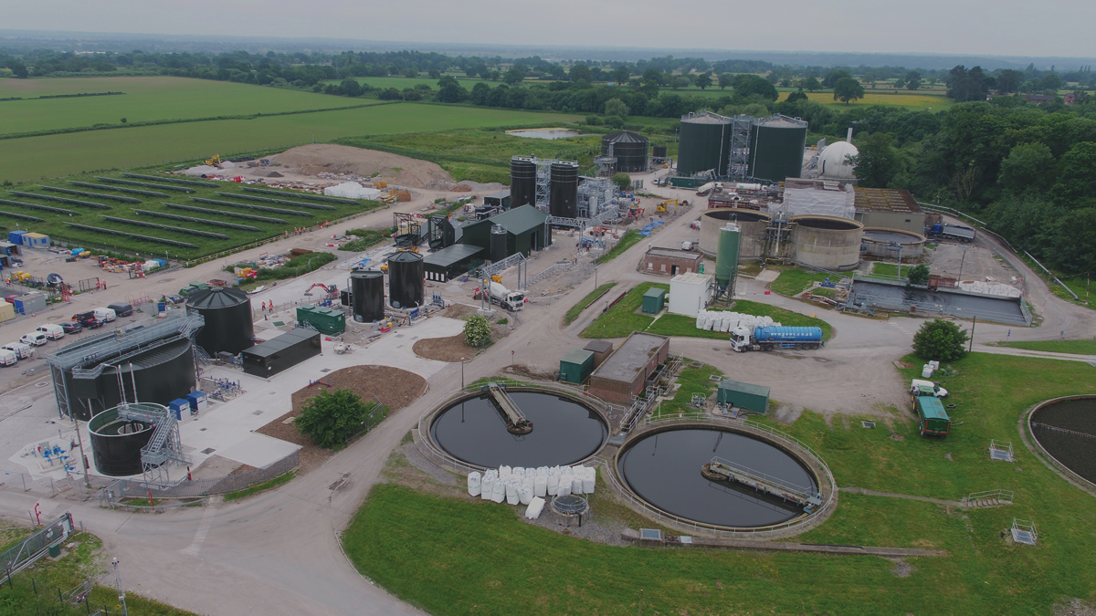
WWTP INFLUENT ANALYSIS

Slide 30
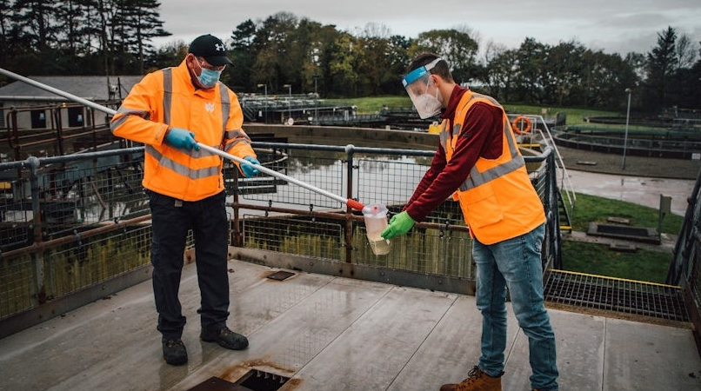
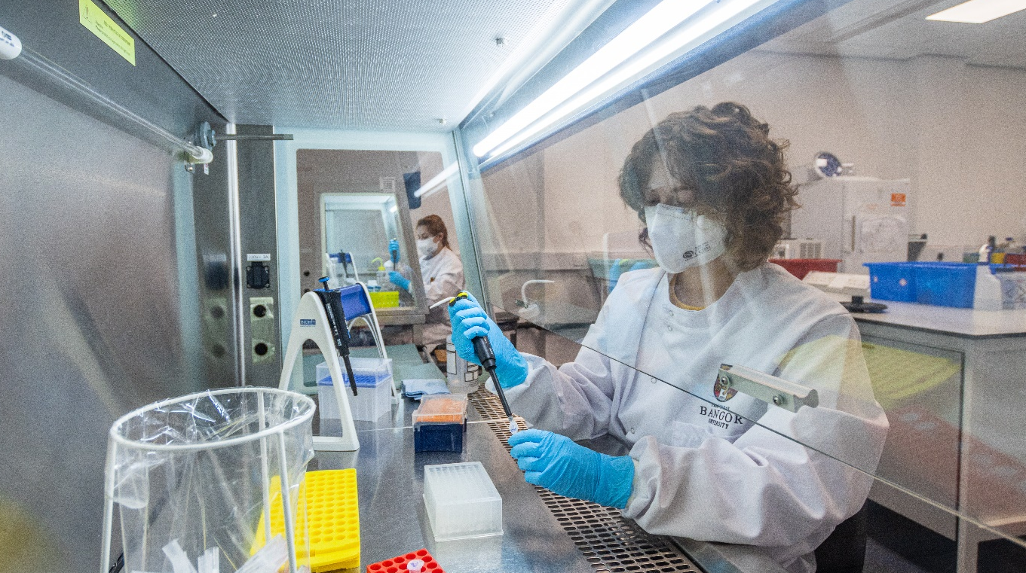
Wastewater-based surveillance
Wastewater offers an efficient means of monitoring AMR
Levels of AMR in influent wastewater can reflect clinical levels
AIM 1
Determine the factors influencing the spatial variations in the influent resistome

Slide 31
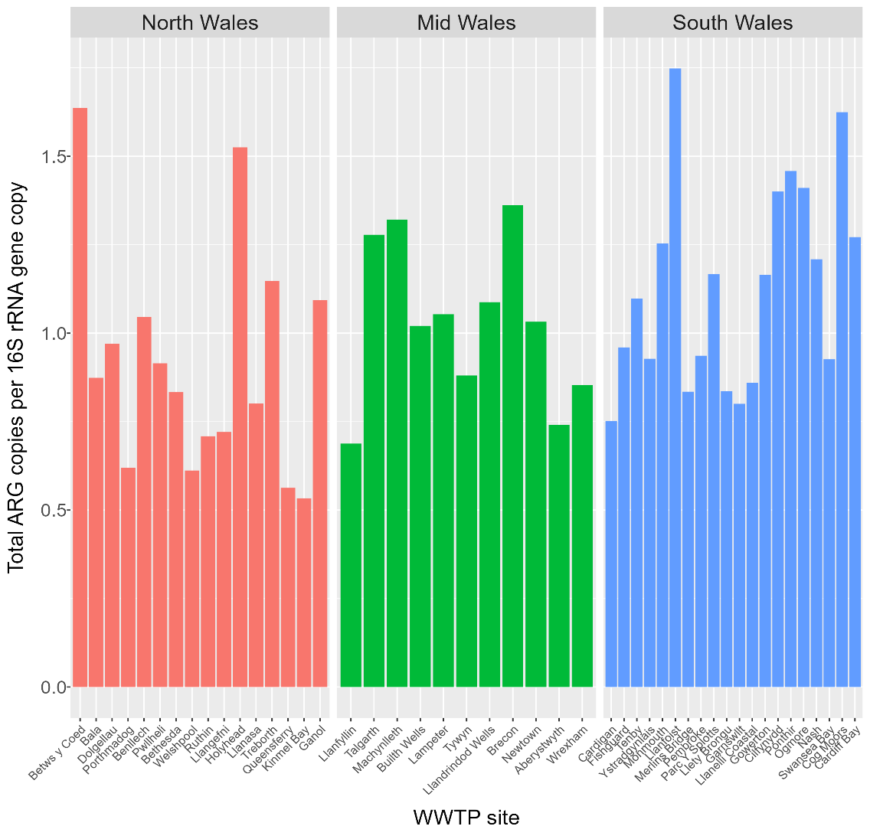
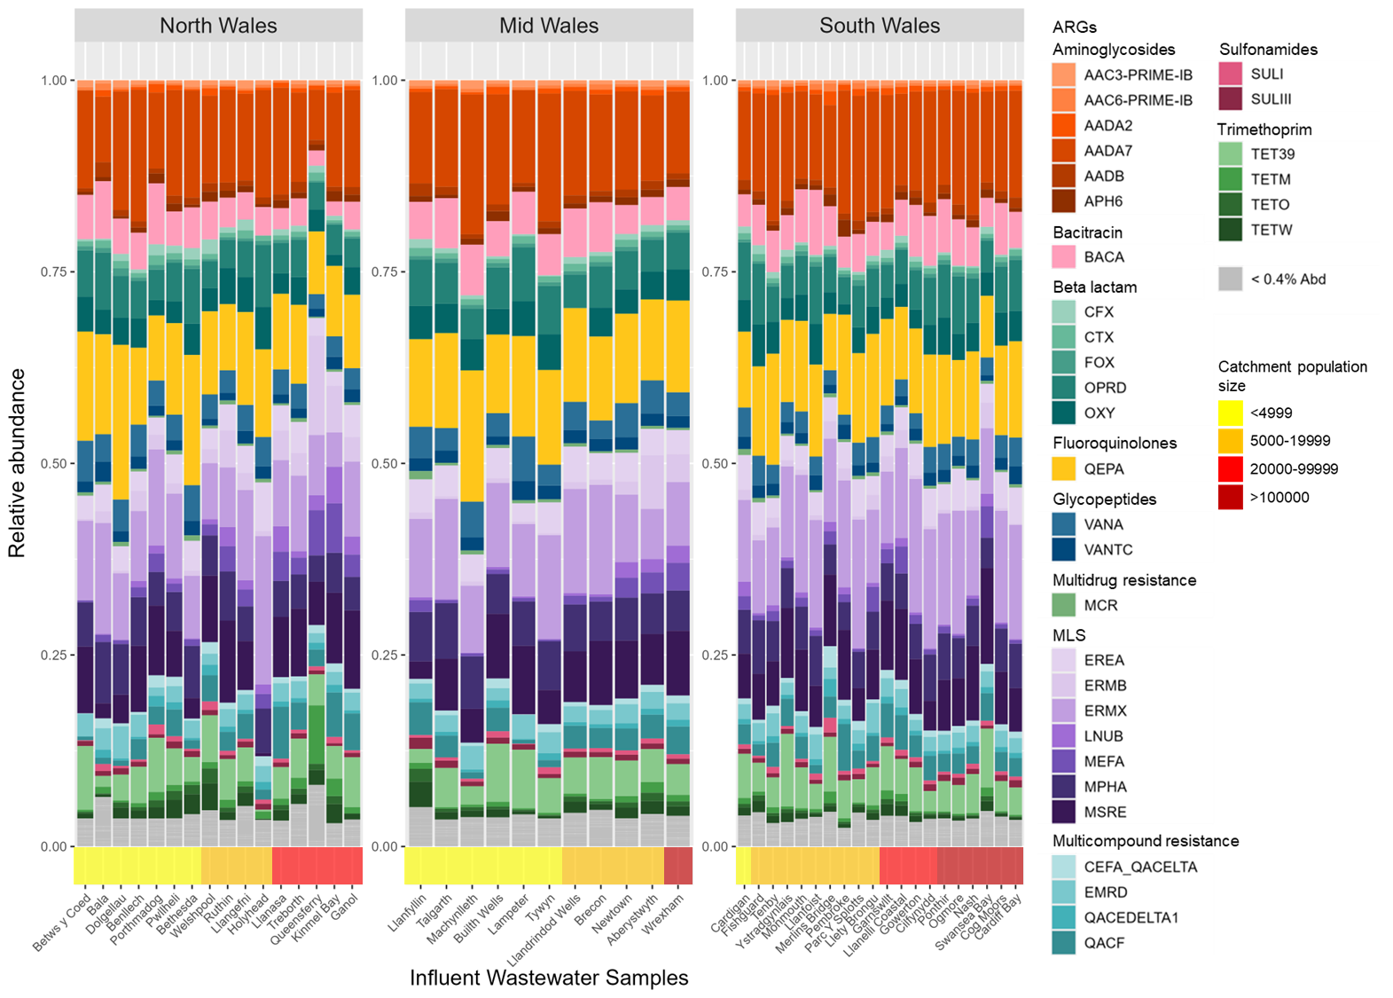
Influent resistome profile and abundance
The influent wastewater samples displayed similar resistomes (i.e. the collection of ARGs)
Dominated by ARGs providing resistance against MLS antibiotics
The total abundance of ARGs relative to the number of bacteria didn’t differ regionally or by WWTP size

Slide 32
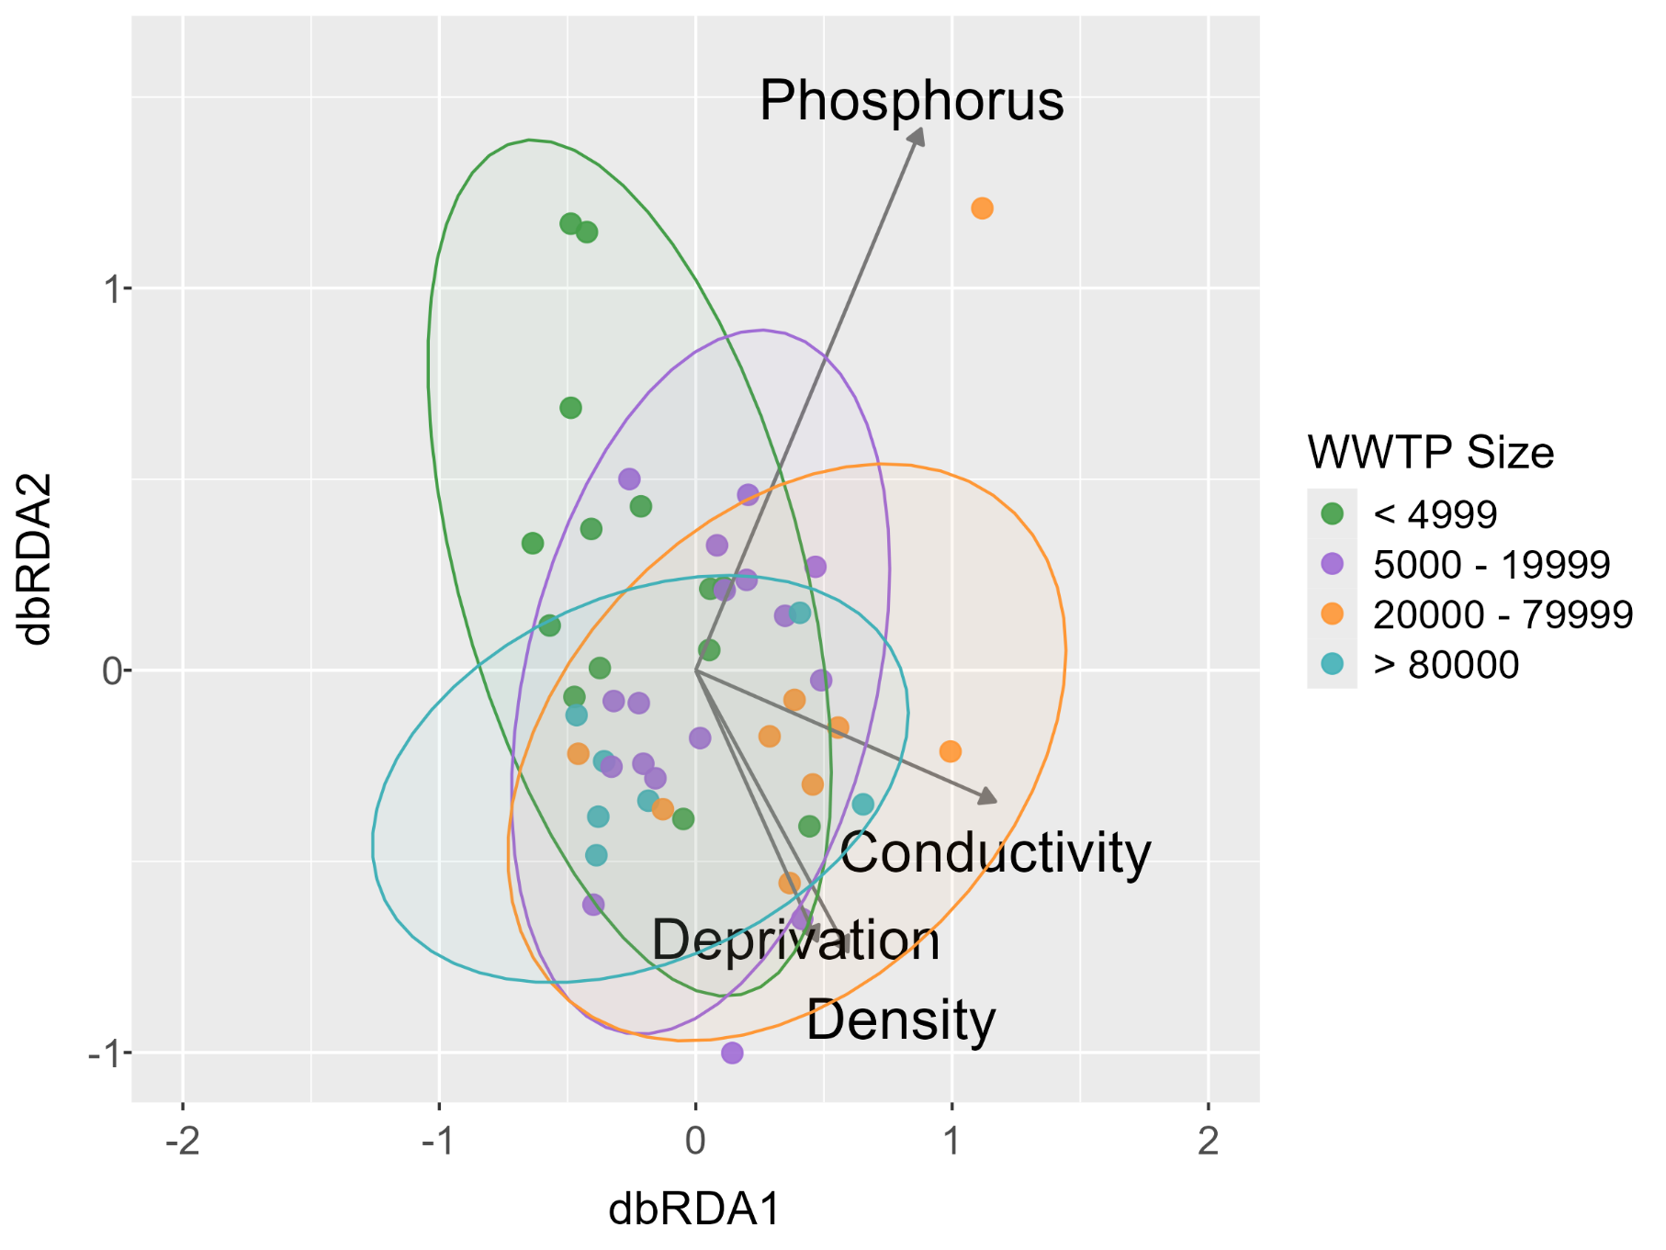
Influent resistome composition
The coloured clusters show that the resistome was influenced by WWTP population size
Four other variables displayed strong relationships with the resistome, including population density and level of deprivation

Slide 33
Conclusions
The resistome composition and total abundance didn’t differ between Welsh regions
The composition was influenced by population size, density and deprivation
  Higher interpersonal contact
  Health inequality
  Higher antibiotic prescribing

Slide 34
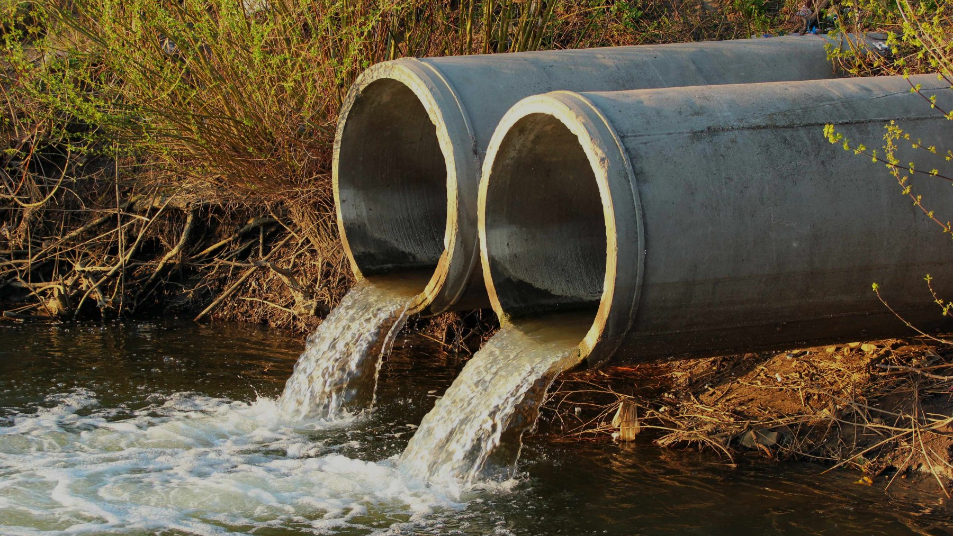
WWTP EFFLUENT ANALYSIS

Slide 35

Wastewater treatment
PRELIMINARY
PRIMARY
SECONDARY
TERTIARY
screening
sedimentation
biological
sedimentation
disinfection
UV
UV
INFLUENT
EFFLUENT
Activated sludge or filter beds etc.
UV or chlorination etc.
SLUDGE TREATMENT
Conventional wastewater treatment typically operates through a series of physical and biological treatment steps

Slide 36
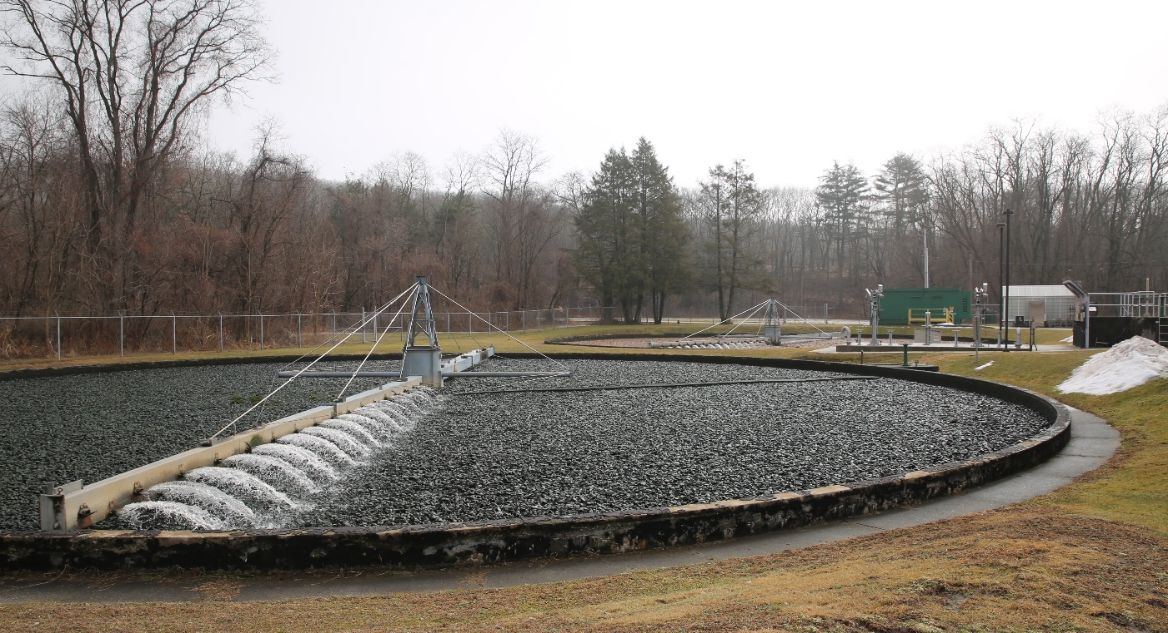
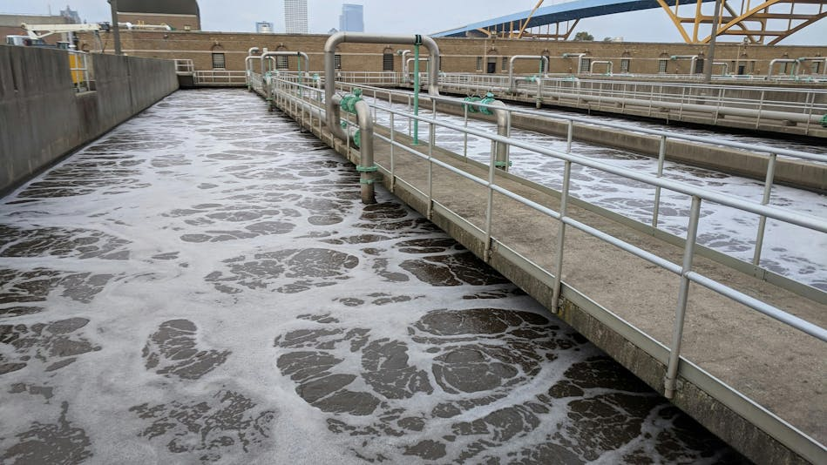
Wastewater treatment
Welsh WWTPs predominantly perform either biological filtration or the activated sludge process
Some Welsh WWTPs perform an additional UV disinfection step
AIM 2
Assess the impact of different treatment technologies on the abundance of ARGs in the final effluent

Slide 37
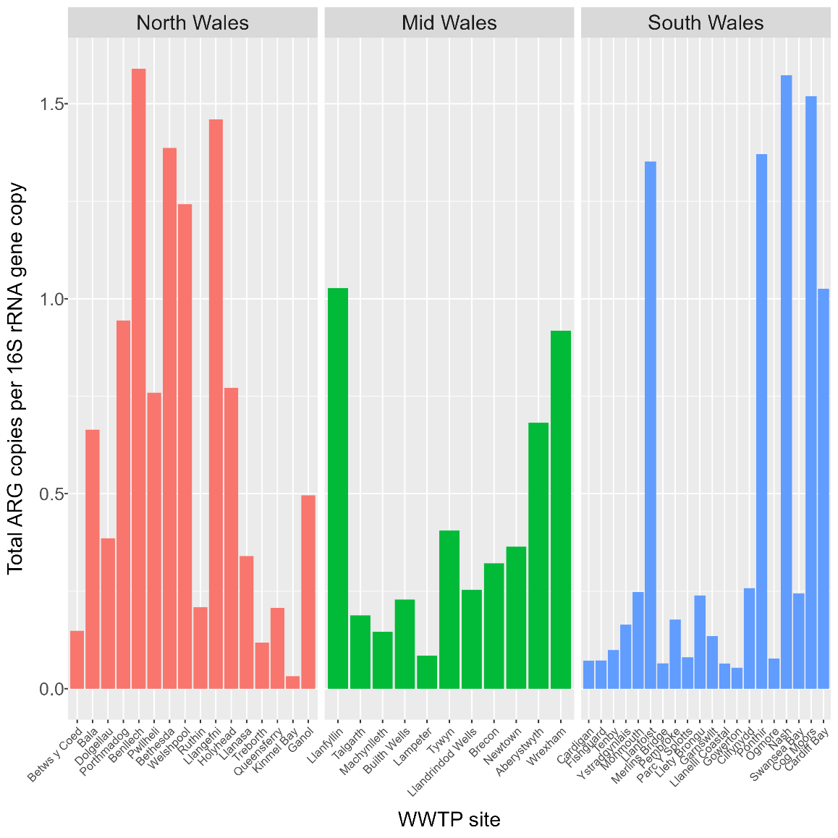
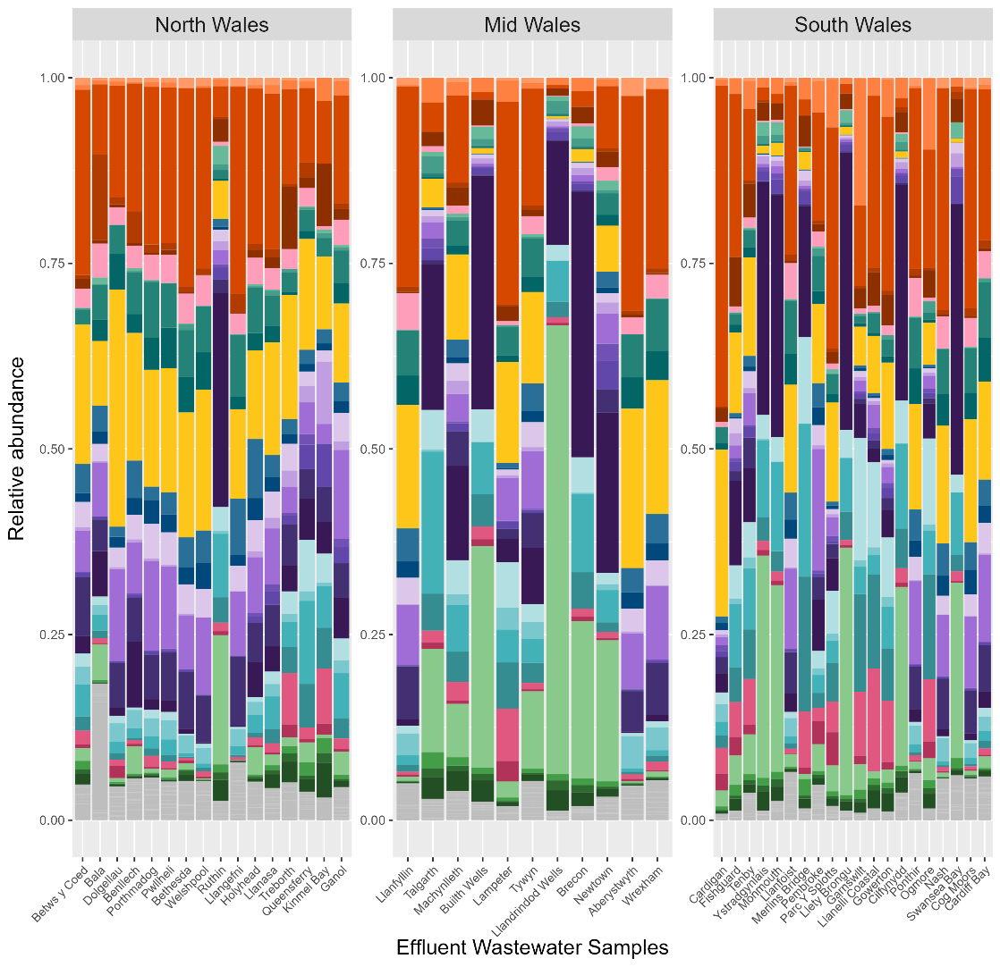
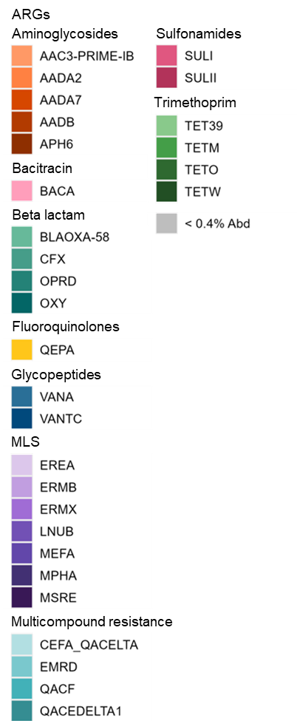
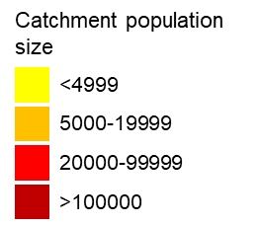
Effluent resistome profile and abundance
The influent and effluent ARG profiles are similar, with some differences, e.g. in aadA7 and MLS ARG and abundances
The total abundance of ARGs again didn’t differ regionally or by WWTP size

Slide 38
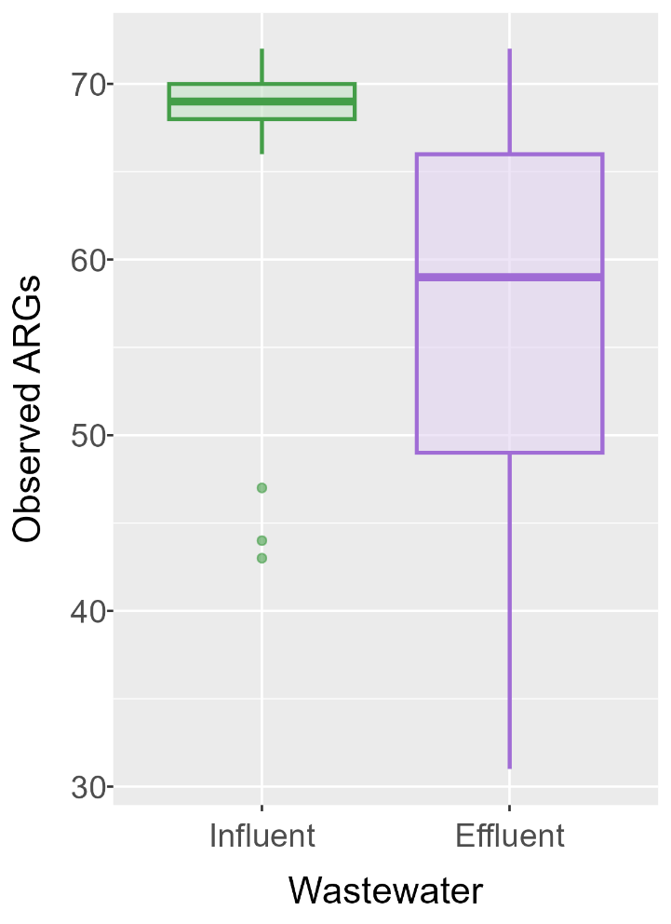
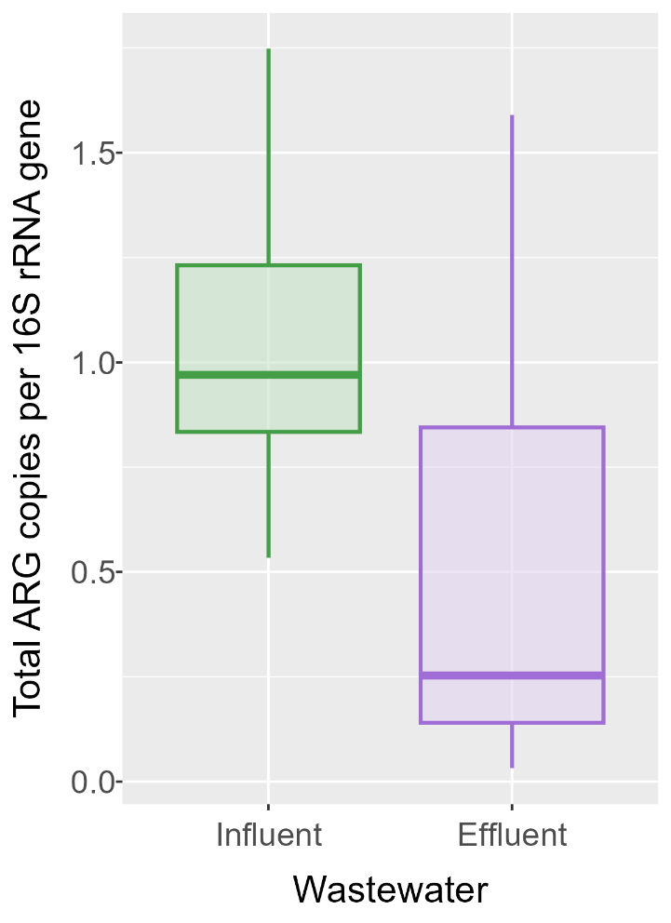
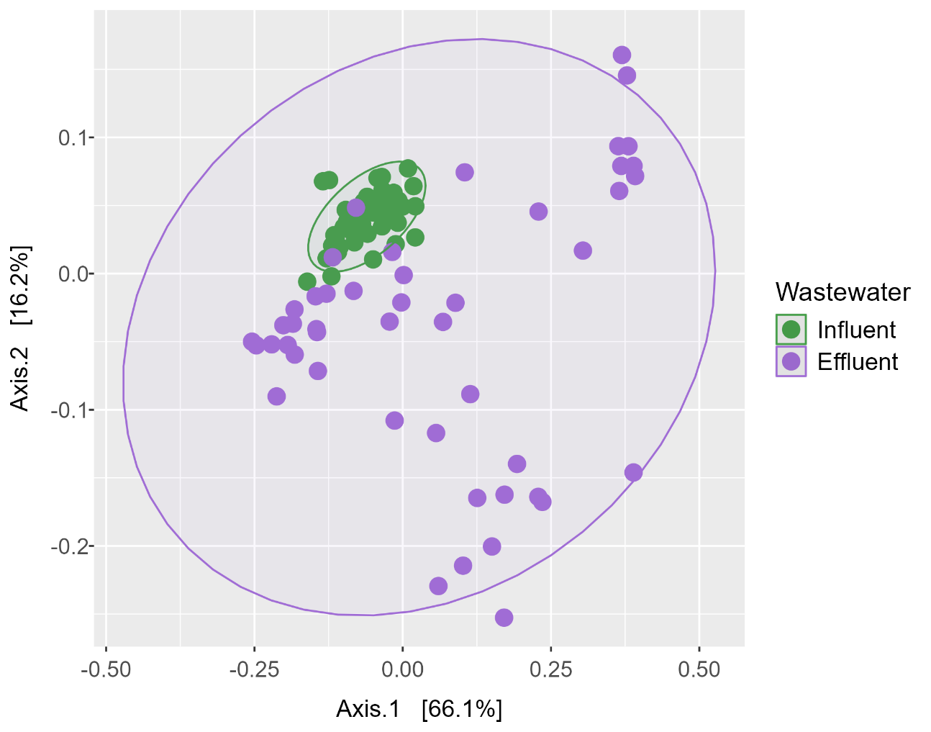
Comparison between influent and effluent
The effluent resistome’s composition was distinct and more variable than the influent
The number of observed ARGs and their total relative abundance were higher in the influent

Slide 39
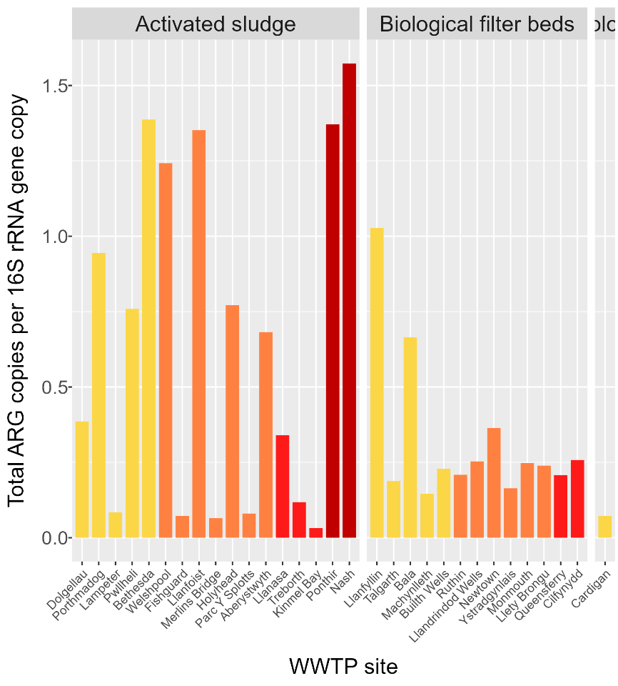
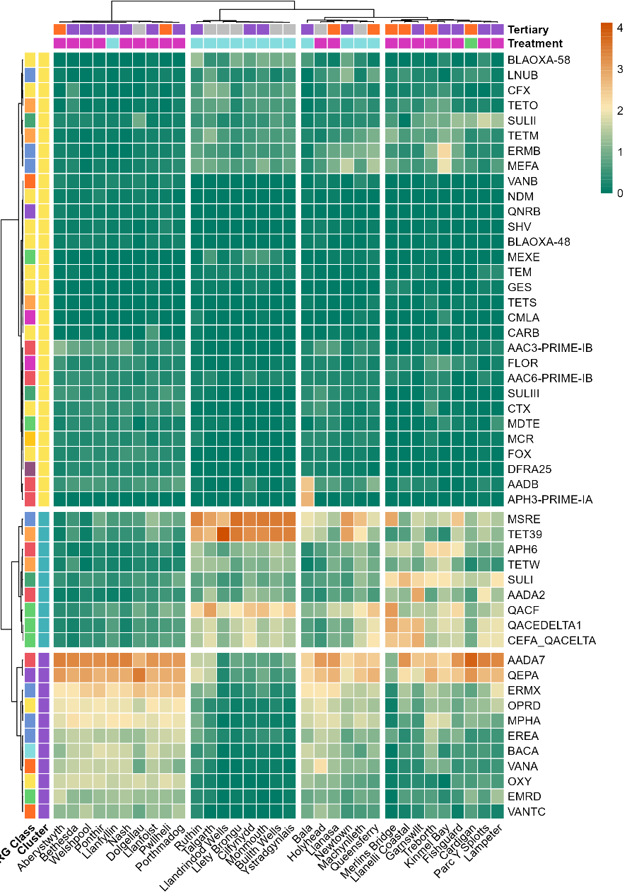

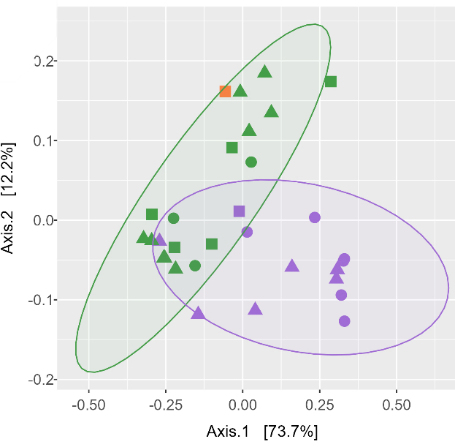
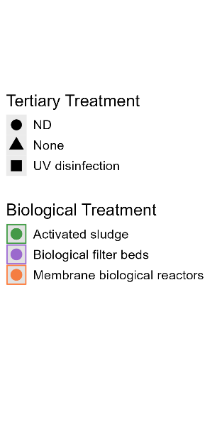
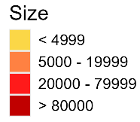
Comparing wastewater treatments
M
Activated sludge clusters
The choice of biological treatment impacted resistome composition
Tertiary treatment did not impact resistome composition
Biological filter bed clusters
The total abundance of ARGs was higher and more variable for Activated sludge WWTPs

Slide 40
Conclusions
The number and relative abundance of ARGs was reduced by the wastewater treatment process
Biological treatment impacted the composition and abundance of the resistome
  Differences in environmental conditions
  Differences in microbial community

Slide 41
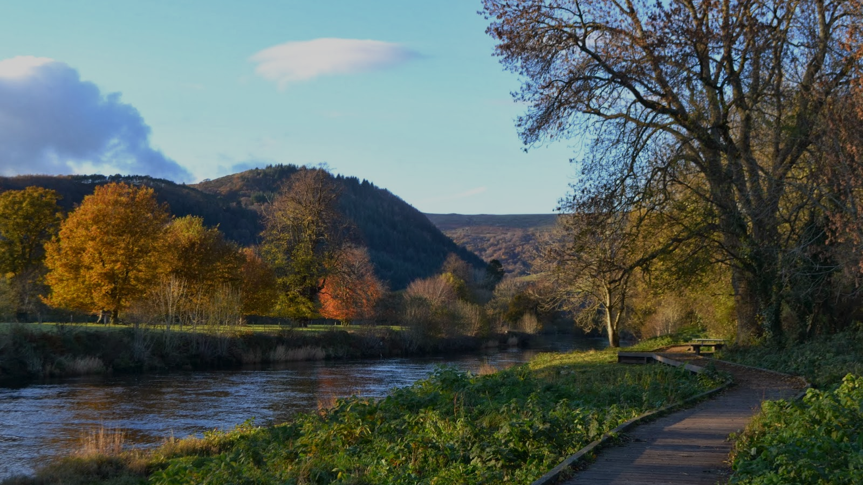
ENVIRONMENTAL ANALYSIS

Slide 42
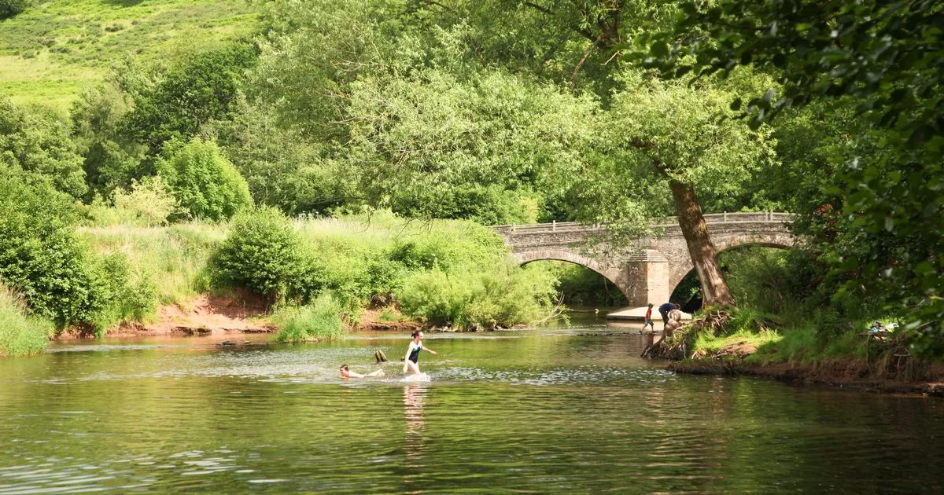
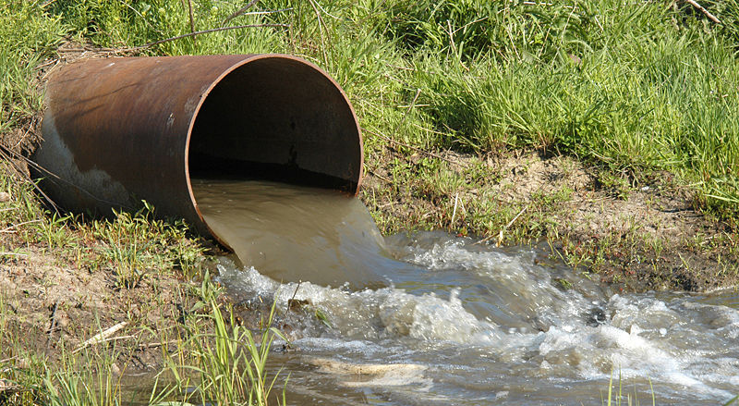
Environmental impacts
Wastewater is a source of AMR pollution in the natural environment
Contaminated water puts bathers at risk of exposure to AMR bacteria
AMR bacteria can re-enter the food chain though shellfisheries etc.
AIM 3
Evaluate the influence of effluent release on the resistome of downstream sediment samples

Slide 43
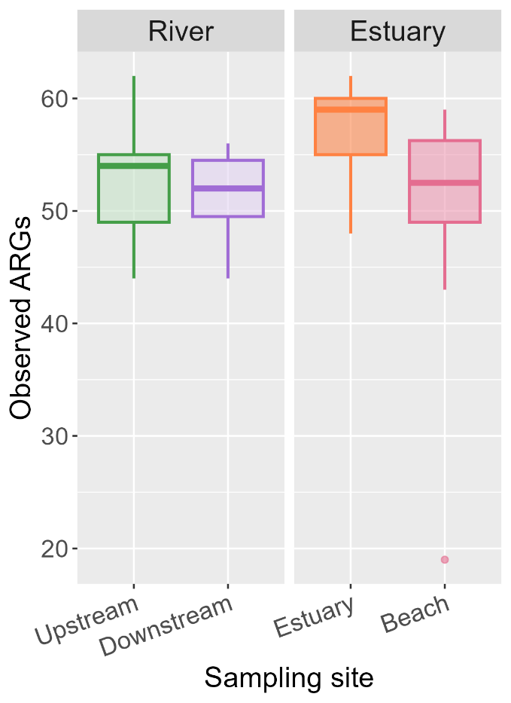
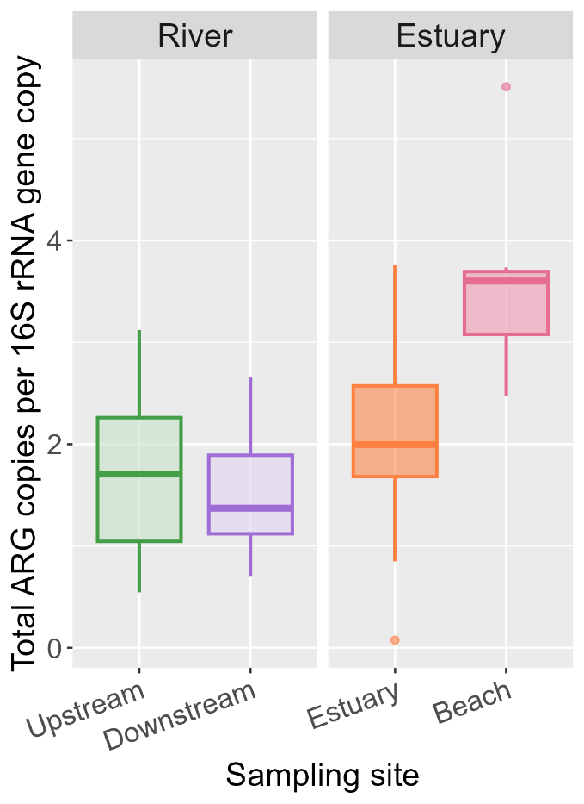
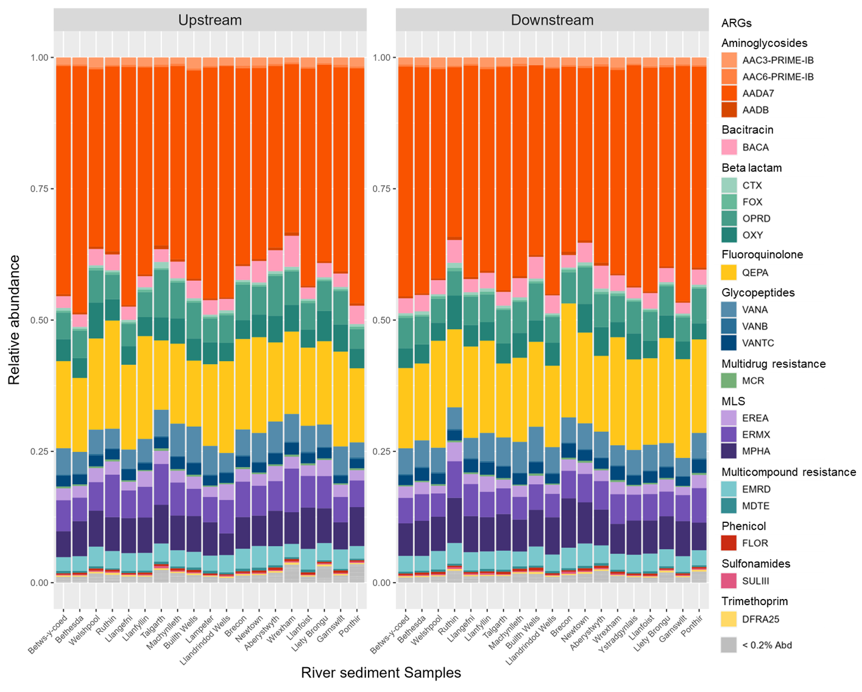
River and estuary sediment ARG profiles and abundances
River sediments collected up and downstream to effluent discharge points displayed similar resistomes, dominated by aada7
The number of observed and total abundance of ARGs didn’t increase downstream
Both were higher in the estuary sediments

Slide 44
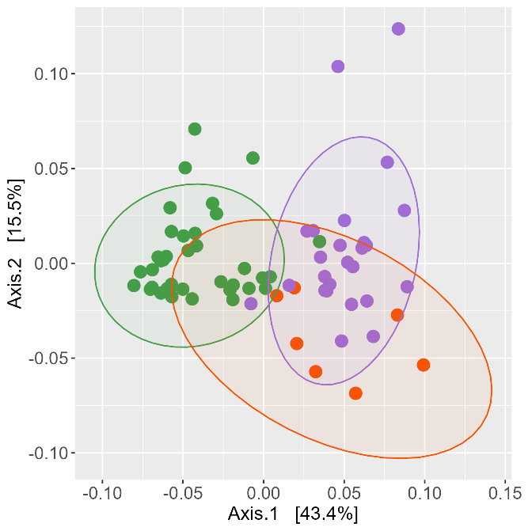
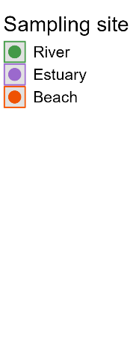
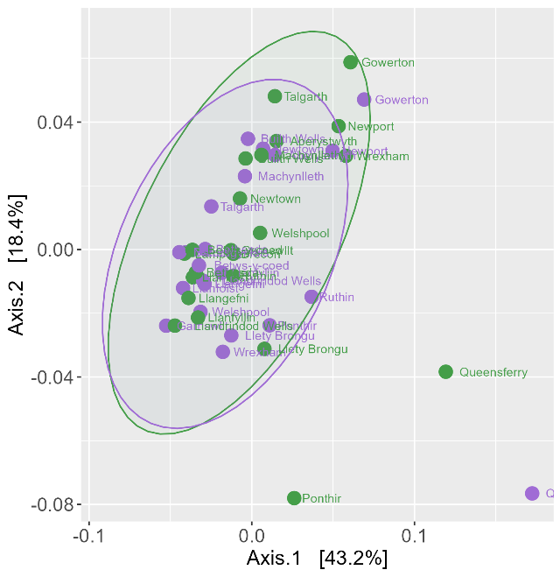
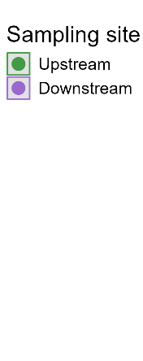
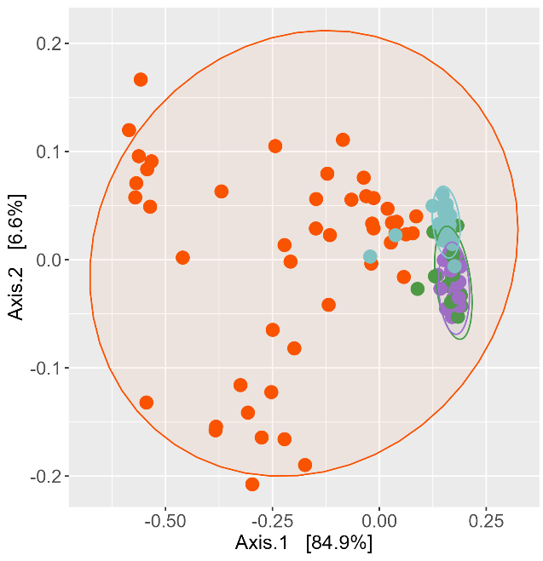

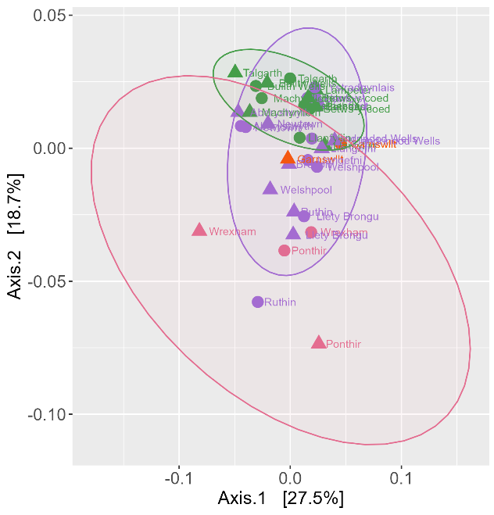

River and estuary sediment resistome composition
The upstream and downstream river sediments displayed similar resistomes
The sediment resistomes clustered by sample type
The effluent resistome was distinct and more variable than the sediment resistomes
The river sediment resistomes clustered by WWTP size

Slide 45
Conclusions
The composition of the resistomes were distinct between sediment types and from the effluent
Effluent discharge did not increase the abundance of ARGs downstream
  Are the ARGs naturally occurring or pollution?

Slide 46

Future research
Wastewater
The effect of population density and deprivation on AMR
The optimal treatment for AMR removal in WWTPs
The risk of AMR exposure to WWTP workers
Environment
Sources of AMR in sediments
The impact of effluent release on river and estuarine surface water
The impact of CSO release
The risk of AMR transmission to bathers

Slide 47
ANY QUESTIONS?

Slide 48
Break
Return to this room at 11:30 please

Slide 49
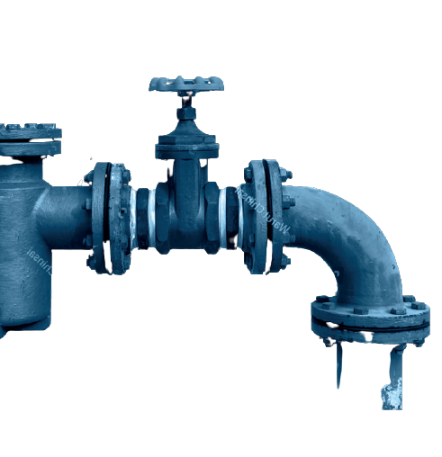

Drinking Water
Wales 2023
Marcus Rink
Chief Inspector of Drinking Water

Slide 50
Overview
Public Water supplies in Wales
  Drinking water quality compliance
  Events
  Discolouration
  Asset Risks
Private Water Supplies in Wales
  Overview
  Compliance
  Sampling
Research "Impact and future of the regulatory model and legislative framework surrounding private water supplies in Wales"
Notes:
Acceptability, why is there such as issue in Wales, don't cover what companies are doing as they will present on this
CCW
Ofwat ODI, what are they doing about this and what financial penalty does this incur.
Events and ERI
Drought / freeze thaw

Slide 51
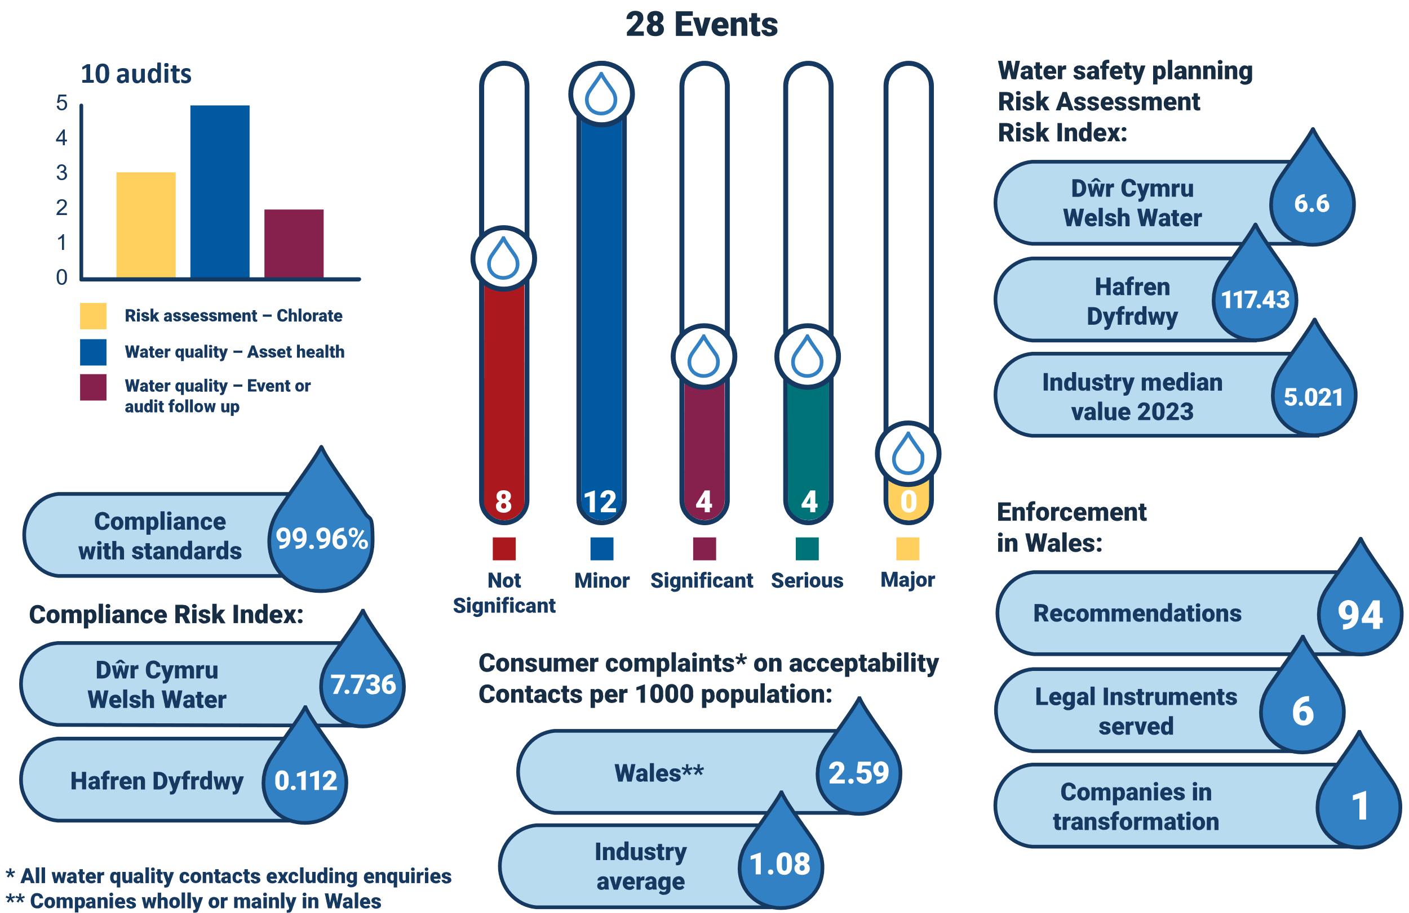
Industry dashboard
Public supplies​ | Statistics​
Population supplied​ | 3,361,000
Water supplied (L/day)​ | 927,081,000
Abstraction points​ | 80
Treatment works​ | 72
Service reservoirs​ | 411
Water supply zones​ | 102
Length of mains pipe (km)​ | 30,517
Surface sources​ | 93.25%
Groundwater sources​ | 5.80%
Mixed water​ | 0.95%
318,18 Tests
*WTW 61; SR 102
Notes:
2022 – 33 events. Main changes in 2023 6 to 12 minor events; 19 to 4 sig events but increase in serious events 1 to 4. This due to 2 x chlorate, as Ct and a Tb at WTW. Increase of 40 recommendations or increase of 75%. Small rise in acceptability complaints from 2.51. Rise in CRI for DWR from 5.397 but drop for HDD from 0.563. Similar number of audits but more of a focus on chlorate and asset health. Drop in MZC from 99.97.
Lake Bala 18BL Wales 0.927 BL = 19.5 Days.

Slide 52

Compliance with standards in Wales 2023
Parameter group | % Compliance
Chemical Parameters | 99.95%
Indicator Parameters | 99.97%
Microbiological Parameters | 99.97%
Pesticides | 100.00%
E. coli at WTW | 100.00%
E.coli reservoir | 100.00%
Overall | 99.96%
Notes:
Number of tests down from 318,184 and breeches up by 5. 65 are DWR and 8 HDD ( 4x Z colis, 3x SR Colis & 1 Taste). Copper result of 2.2 mg/L at consumers tap, significant lengths of internal copper pipework within the property. Flushing advice given to consumer but no further advice on remedial works or potential health advice. 2 Tb in Z NCF. 13 Colis DWR in SR all covered by LI. All but 2 Fe covered by LI. 2x Odour DDS but 1 = burst main. The zonal iron breaches are ultimately attributed to the poor condition of cast iron mains, with iron liberating from the walls of the mains and accumulating as sediment. Typically, mains are put on monthly, fortnightly, or even weekly flushing programmes following iron failures. There were 10 taste and odour breaches in Wales in 2023, a reduction from the eleven breaches which occurred in 2022. Seven of these breaches were the result of taste analysis cancellations at the laboratory. The majority of these detections and of the laboratory analysis cancellations were associated with the presence of particulates arising from the poor condition of upstream mains and the disturbance of associated sediments. 33% of DWR failures due to DDS but 50% of HDC

Slide 53

PFAS surveillance in Wales 2023
Company | <LOD | Tier 1 | Tier 2 | Tier 3
DWR | 14,575 | 254 | 4 | -
HDC | 1,286 | 4 | - | -
THPFOS – 50% 2 detections
PFOS – 25%
1 detection
PFBA – 25%
1 detection
Information Letter 03/2024 introduces the ‘sum-of’ PFAS into the Tiers and Actions system.
Notes:
Where sites fall into tier 3 (≥0.1 µg/L), the Inspectorate expects companies to put
in place emergency contingency measures to reduce concentrations to below 0.1
µg/L in water supplied to consumers. Furthermore, the revised guidance requires
companies with sources that fall into tier 2 (<0.1 µg/L) to design a proactive and
systematic risk reduction strategy. This shall include a prioritised mitigation
methodology to progressively reduce PFAS concentrations in drinking water. This
requirement has been further extended to include combined PFAS on a ‘sum of’
Basis

Slide 54
Compliance risk index

Slide 55
Compliance risk index
Notes:
Felindre – ingress colis in FWT tank -External inspections of both contact tank 2 and the north compartment of the final water tank identified multiple issues with the potential to allow ingress. In one case a defective cable duct seal had been repaired with paper. The appears to be a number of fluid category 5 backflow prevention infringements associated with the service and motive water system - recommendation made to address these. Tanks to be taken offline early next year for internal inspection - unable to do sooner as repair work ongoing on alternative disinfection stream tanks. Dolbenmaen WTW - Five tonnes of sand found in Contact Tank 1A and in underdrain of filter 4. Filter 4 taken out of supply in response but subsequent inspection by contractor did not identify any issues. No media loss identified in remaining filter underdrain camera survey and floor inspections ongoing. Gwastadgoed WTW - Inspection text for compartment 1 of the final water tank: “There is some root growth inside one of the hatches, this appears to be growing inside the tank or is growing from the outside through one of the plates.” Corroded bolts also identified preventing the lifting of a hatch. Compartment 1 taken out of service for inspection and repairs and passed subsequent flood test. Water passing between compartments inside final water tank so enabling works required to allow safe access for inspection of compartment 2 - ongoing. Enhanced sampling has been initiated as mitigation in the interim.

Slide 56
Proportion of CRI by failure and parameter
Top 10 CRI scoring failures

Slide 57

Water Quality Events 2023
Notes:
2 chem contamination is a catch all (Hatfield – coal tar) Abadere. 57% out of company control. 4 events due to HDC all DND Lead, ingress burst, internal tank odour, caravan site fittings. ¾ for HDC are consumer side.

Slide 58
Event risk index
Notes:
Please note, I had to move 6 companies over to the secondary axis so that Dŵr actually appeared at a decent scale. The industry median uses the left hand primary axis, it does not relate to those on the secondary axis.

Slide 59
High scoring events 2023
Notes:
An operational monitoring sample was taken from Capel Curig WTW on 22nd August 2023. On the evening of 24th August, a chlorate result of 700µg/l was reported. Penyball - A routine operational sample taken from the outlet of Penyball SRV on 10th August reported a chlorate result of 1000µg/l on 16th August. Deterioration of sodium hypochlorite in all cases. An operational monitoring sample was taken from Penycefn WTW on 24th July 2023. On the afternoon of 31st July a chlorate result of 930ug/l was reported. The sodium hypochlorite storage tanks have been drained and refilled.
At approximately 02:00 on 11th May 2023 a burst occurred on the 18” trunk main supplying Leckwith Service Reservoir.As a result customer reports of loss of supply were received from areas supplied by the trunk main.
At 19:35 on 10th November Bryn Cowlyd WTW works was restarted after an automatic shutdown. Following the restart, a pH probe fault resulted in an increase in Kalic dosing, which caused the disinfection pH to increase. As a result of high pH at the point of disinfection, the calculated Ct value dropped and was below the minimum required level (as described in the works Site Specific Disinfection Strategy) for approximately 3 hours between 20:30 on 10/11/2023 and 02:00 on 11/11/2023.
On 26th October a camera survey was completed on the pumping main from Penybont WTW to Escuan Final Water Tank to locate a suspected leak. Water in the pumping main was diverted into an isolated compartment of the final water tank for the duration of the survey. Following completion of the work, elevated turbidity was observed on the inlet and outlet of the final water tank. Final water turbidity breached the PCV of 1NTU at approximately 16:30 on 26th October and remained above 1NTU overnight until approximately 11:30 on 27th October.

Slide 60
Whole industry discolouration rate 2023

Slide 61
Discolouration rate per 1000 population

Slide 62
Discolouration prediction
Notes:
Marcus – you requested this slide.

Slide 63
Taste and odour contact rate 2023

Slide 64
Top hazards RARI score – r.27 risk assessments
Clostridium perfringens
Cryptosporidium
E. coli

Slide 65

Water Quality Impacts: Chlorate
Notes:
No/insufficient chlorate management policies in place for majority (80%) of companies
Inadequate chlorate sampling programmes for many companies (70%)
Many (75%) companies do not have or are not responding to chlorate trigger values
Many companies (ave. 60% across the different questions) are not complying with BS EN 901:2013 requirements
Reg 27 risk assessments are inadequate for approximately half of the companies

Slide 66

Lead pipe replacement
Notes:
Marcus – some English companies didn’t like this as it didn’t consider future potential investment. This is clear an extrapolation of this AMPs investment so I think this is unfounded.

Slide 67
Service reservoirs
% of assets at risk (Wales) 2021 - 6.12% 2022 - 6.75% 2023 – 4.54%

Slide 68









Asset Risks
Notes:
Oversized sodium hypochlorite storage tank at Penyball SR – top LH corner.
Hypochlorous acid to hypochlorite ion ratio (Bryn Cowlyd CT event) - graph.
Unsecure external hatch over contact tank at Dinas Mawddwy works – top RH corner.
Livestock grazing in proximity to spring source (Llanymawdwyy works, UV in operation)
Tanker without a sample tap – far right middle.
Network discolouration at flushing point during Gilfach Fargoed burst response (red pipe).
Talybont – bottom right – 2MIB extremely high – algal blooms usually rare at this site.

Slide 69

Private Water Supplies Overview

Slide 70

Private Water Supplies
Notes:
Note on the reduction of failures but with caveat

Slide 71

Private Water Supplies

Slide 72

Private Water Supplies & Risk Assessments

Slide 73

Research

Slide 74
Aims
"What impact has the [revised] legislative framework for PWS had on the protection of the health of consumers through securing safe and sufficient supplies [since 2010]?"
"How could the current regulatory model and legislative framework be improved?"

Slide 75
Methods
Reviewed 10 years’ worth of PWS sample data.
Questionnaires to 28 local authorities.
One to one interviews with 20 local authorities.
Reviewed literature, websites, case-studies and the wider legislation.

Slide 76

Observations and conclusions
While overall compliance with the standards has improved over the last 10 years, the number of water quality tests which failed the standard for total coliforms and E. coli – key markers of public health risk – is around one hundred times greater from private sources than from the public water supply.
Number (top)
Percentage (bottom) of tests that had at least one failure for Wales

Slide 77

Observations and conclusions
Percentage of E. coli and coliform bacteria samples that have failed annually in Wales

Slide 78
Observations and conclusions
Many private water supplies serve a single dwelling for domestic use only. These dwellings are rarely subject to any risk assessment or sampling to check water quality since the Private Water Supplies Regulations do not require it. This means that a significant minority of the population who consume drinking water from a private supply are at greater public health risk than consumers from a public water supply.
The current water quality legislation does not safeguard the health of all consumers equitably, and that consumers of private water supplies in rural areas may be disproportionately disadvantaged economically should they wish to connect to a public supply.
limitations on the statutory duties of the DWI, and the availability and funding of sufficient experienced practitioners in Local Authorities. The result is that the Private Water Supplies Regulations are not always enforced, water quality sampling is sometimes inadequate, and mandatory risk assessments are not always in place.

Slide 79

Observations and conclusions
Proportion of PWS sites in Wales that have a risk assessment carried out between 2015 and 2019
Notes:
54.1% with an in-date RA for 2023 in slide 25 so this is still a lot of work to be done to achieve full coverage.

Slide 80

Observations and conclusions
Ease of data reporting process to the Secretary of State
Notes:
We would certainly like to improve this and will continue to work with LAs on improving processes and facilities.

Slide 81
Observations and conclusions
Potential barriers to implementation of the legislation
Cost recovery
Availability of suitably qualified and competent resources
Deprioritisation of duties
Regulatory Power
Ability to Enforce

Slide 82


Observations and conclusions
Representation of divergence of accountability and responsibilities to meet public health outcomes in public and private water supply systems in England and Wales

Slide 83

Observations and conclusions
Stakeholders with direct and indirect impacts on private water supply outcomes

Slide 84

Observations and conclusions
Estimated cumulative cost per dwelling, for supplies to single dwellings, to connect to the public supply or maintain an existing single PWS, by source type
Estimated gross and net costs to connect to public water supply for single dwelling and shared supplies (domestic purposes only) – overall net benefit to connecting
Notes:
Comparing the 50-year estimated cumulative cost to consumers at each dwelling in maintaining their existing PWS as supplied from a groundwater source (grey line), surface water source (orange line), or onward distribution of a public supply (blue) to the estimated average cost to connect a dwelling to a public supply based (yellow line) on developer cost calculations plus ongoing payment of a water bill for the remaining 50 years at today’s prices, all discounted according to Treasury Green Book guidance at 3.5% up to year 30 and 3% thereafter.

Slide 85
Conclusions and recommendations
Refinement of the current framework could achieve improvements needed
Other activities not involving/requiring legislative change could also achieve some desired benefits.

Slide 86
Proposed Interventions
1. Resources for governing body
2. Harmonisation and modernisation of legislation
3. Additional resources for local authorities
4. Economic considerations
Notes:
Maybe an opportunity to mention Defra plans for water legislative reform?

Slide 87


Drinking Water Inspectorate
 : dwi.enquiries@defra.gov.uk
: www.dwi.gov.uk

Slide 88
Lunch
Please take the opportunity to network
Return to this room ready for afternoon session at 13:15 please

Slide 89
Welcome back
Oliver Twydell, Water Regulations and Public Health Business Leader, Hafren Dyfrdwy
Member of Water Health Partnership Steering Group
Chair of afternoon session

Slide 90
Agenda

Slide 91
Water Incident Management
Workshop/ Scenario
Diane Watkin, Environmental Health Officer, Powys County Council
Chair of the Private Water Supplies Task and Finish Group

Slide 92
Workshop session
Tables 1 & 2 – Move to Cader Room 1 (Facilitator – Anna Schwappach)
Tables 3 & 4 – Move to Cader Room 1 (Facilitator –Adriana Kiss)
Tables 5 & 6 – Move to Cader Room 2 (Facilitator – Mark Porter)
Tables 7 & 8 – Stay in this room (Facilitator – Kate Willis)
Table 9 &10 - Stay in this room (Facilitator – Julia Mansbridge)
Please be back in this main room for 14:20 for feedback session

Slide 93
Feedback on Workshop session
Carol Weatherley, Public Health and Research Manager, Dŵr Cymru Welsh Water

Slide 94
Break
Return to this room at 14:55 please

Slide 95
Water Health Partnership for Wales: Public Health Update
Andrew Kibble, on behalf of UKHSA and PHW

Slide 96

On-going work
Per- and polyfluoroalkyl substances (PFAS)
  Some adverse effects reports in animal studies and in humans
  Cancer?
  Toxicity data for many PFAS limited or unavailable
  COT PFAS group reviewing the evidence base
  UKHSA part of a cross-govt working group on PFAS
  PHW and UKHSA will support water companies and Local Authorities where a public health risk assessment is required
  Updated guidance from DWI
Lead
  Water UK Steering Group
    “lead free” drinking water
    Standard advice and communications on lead and health (in development)
  Wales
    Strengthening collaboration with clinicians and laboratories around lead exposure in children
    Reviewing blood lead data across Wales

Slide 97



Current and emerging issues…
Water (special measures) Bill
  Sewage / wastewater discharges
Recreational waters / wild swimming
Chlorate (and swimming pools)
Climate change
  Drought and insufficiency
  PWS
  Flooding
  Wildfire runoff
Historic landfill sites
Marine / coastal waters
  One Health Coastal Project

Slide 98

Hafren Dyfrdwy –
River Health
Presented By:
Dr Alex Clayton,
Improvement Manager

Slide 99

Introducing hafren dyfrdwy
Hafren Dyfrdwy - which translates as Severn Dee - was formed in 2018 from the coming together of Dee Valley Water and Severn Trent to form a new water service for our customers in Wales.
We have over 130 employees based across our office locations and operational sites.
We provide clean water to around 100,000 customers and wastewater removal and treatment for around 20,000 customers in the heart of Wales. We are funded entirely by revenue from these customers.
We provide 61 million litres of drinking water per day and we take away 18 million litres of wastewater via our network of over 3,000km of water and sewer pipes.
We're only 28% of the size of Portsmouth Water, the second smallest water company, and only 2.4% the size of South West Water, the second smallest wastewater company.

Slide 100





River Health: What is Get River Positive?
At Hafren Dyfrdwy we believe River Health is critical for nature to thrive alongside the communities around them. In July 2022 we joined Severn Trent Water and Anglian Water to commit to five key pledges to improve river quality.
There are Five Pledges:
  Reduce our harm to rivers
  Work with local communities to encourage more engagement with water and raise the importance of safety
  Support others to improve and care for rivers through legislative changes or through our community fund offerings
  Enhancing rivers including working in partnership with others to create new habitats and restore peatland
  Be open and transparent about performance and our plans

Slide 101
Storm overflows in Hafren Dyfrdwy

Slide 102




Storm overflows – an overview
When it rains heavily, our network and treatment works can become overwhelmed - this is when our SOs (storm overflows) release the excess water into the local watercourses – also known as a spill.
SOs are designed to release excess water, to prevent homes and businesses being flooded.
HD were one of the first companies to have monitoring in place on 100% of our SOs. The data is publicly viewable on our live spill map. We are also making a few changes to improve the map following feedback.
In 2023 our 49 SOs had an average of ~38 spills varying from 0 to 152. We’re committed to near term reduction to the number of spills from our assets.
Notes:
Introduce concept of storm overflows
Talk briefly through the diagram of their operation and the photo of an actually overflow (Llanfair Caereinion Bridge St)
Talk briefly though the map, explaining the key

Slide 103



Action on storm Overflows
During 2024:
We have investigated all sites with 20 or more spills and are improving sites responsible for >50% of our spills.
Solutions include raising the weir heights on overflows, installing novel storage tanks at treatment works, sealing manholes and relining sewers to prevent infiltration, and fitting river flaps or non-return valves to stop rivers getting into our sewers during flood events.
With 100% of our SOs now monitored we’ve had a big push to use this as effectively as possible. This includes using an AI approach to identify when sewers may be impacted by partial blockages so we can intervene before spills happen.
During 2025-2030:
We will be classifying all SOs under a new NRW approach to identify any that are causing harm and should be prioritised. We will ensure 60% of our SOs cause no harm, or very low harm, by 2030.
We have proposed investing £10.9 m to reduce spills to <20 on average using solutions including NbS treatment options, SuDS and adding storage capacity within our sewer network.
During 2030-2035
We will be delivering solutions to tackle SOs that have been flagged as causing harm by NRW’s classification scheme.
We have proposed investing to reduce all our assets to <20 spills.
Notes:
During 2024: skim verbally through the slide wording, explain in more detail the three images shown
During 2025: explain the difference between our commitment to NRW and our commitment to Ofwat in our latest PR24 submission
During 2030-35: explain how GN066 upgrades may play out, some low spillers may need further improvements. Explain the Ofwat commitment around <20 spills and how that will take us to around 12.5 spills per asset on average.

Slide 104
Catchment partnerships delivering biodiversity

Slide 105


Lake Vyrnwy Peatland restoration Project
Pollinator Project in Montgomeryshire
Lake Vyrnwy – Peatland Restoration with the RSPB.
  Peatland restoration is key to support not only carbon benefits but also the health of our rivers
  Restoration works include gully blocking, dam creation and repairing ‘hags’ to restore the natural function of the peatland – to hold water and slowly release it back to nature improving quality, flood prevention and biodiversity.
  Conifer removal on the SSSI land owned by HD to ensure we meet statutory responsibilities for SSSI landowners.
Pollinator project focusing on Pearl-bordered fritillary - Montgomeryshire Wildlife Trust (MWT)
Supporting landowners to deliver interventions on 3rd party land and land owned by MWT including bare ground creation, scrub control and woodland management.
Working with local community groups to carry out surveys of the butterfly population.

Slide 106
Partnership working to improve biodiversity in HD
As well as surveying our own sites with a focus to improve them in 2025-2030, the biodiversity team has funded some brilliant work with partners in the HD supply area.
In 2020 we exceeded our performance commitment target by delivering in partnership with the following organisations:
  North Wales Wildlife Trust: 65 hectares – improvement works to old quarry sites with a specific focus on inverts.
  The RSPB: 143 hectares – The RSPB are implementing management actions across our Lake Vyrnwy site including peatland restoration and conifer removal to protect the rare and important peatland habitats.
In 2021 we again exceeded our target by delivering with the following partners:
  Montgomeryshire Wildlife Trust: 7.12 hectares – Pathways for Pearls project focusing on pollinator friendly interventions, especially those favouring the pearl bordered fritillary butterfly which is endangered in Wales.
  The RSPB: 348 hectares - Lake Vyrnwy Peatland Restoration
In 2022 we once again exceeded our target by delivering in partnership with the following organisations:
  Montgomeryshire Wildlife Trust: 5.22 hectares – Pathways for Pearls
  The RSPB: 213.69 hectares – Lake Vyrnwy Peatland Restoration

Slide 107



Future Catchment investment 2025-2030
Two schemes to investigate and mitigate impact of large-scale dams on downstream gravel beds. Restore fish spawning sites within gravels (Lake Vyrnwy / Clywedog Reservoir)
Dee Water Partnership (Hafren Dyfrdwy, United Utilities, Dwr Cymru Welsh Water and Severn Trent Water) – supporting farmers and other landowners in adopting best practice land management, aimed at reducing turbidity in the Dee
Investigations and audits across our operational estate. Biodiversity improvement across our operational estate in line with audit recommendations
Investigation into source of taste & odour, colour and algal bloom issues in upland reservoirs. Catchment based nature-based solutions to improve reservoir water quality and resource resilience
Implement invasive non-native species removal strategy and recommendations from AMP7 risk assessments across our operational estate and visitor sites
Phosphate reduction schemes at five STWs; install secondary treatment at our only septic tank site; investigate reasons for excessive spills and identify solutions to reduce spills (all in Severn catchment)

Slide 108






Our Overall improvement plans for 2025-2030
519Ha peatland restored

Slide 109


Slide 110

Content
What are the Water Supply (Water Fittings) Regulations 1999
How do they impact you?
Regulation 8 Water Supplies
How can we support you?
How can you support us?

Slide 111


The Water Supply (Water Fittings) Regulations 1999
Government Legislation under the control of DEFRA
Enforced by Water Undertakers
Criminal Law
Are designed to prevent:
Waste
Misuse
Erroneous Measurement
Undue Consumption
Contamination
Notes:
These regulations are an act of parliament and subject to Criminal Law, which means that contraventions to them where they are proved in court, can land someone with a criminal record.
Our officers have the power to issue a caution under law and investigate breaches of the legislation.
These powers are a last resort. We work on education, guidance and enforcement in other ways to achieve our key aims.
This Water Supply (Water Fittings) Regulations 1999 are designed to prevent 5 key things on the water supplied by a water undertaken – or mains water as it’s commonly known by. :
Waste or the likelihood of waste – such as leaks in pipes and taps
Misuse or the likelihood of misuse – for example using water supplied for domestic purpose whether metered or not, in a non domestic environment, such as running a business or process
Erroneous measurement or the likelihood of erroneous measurement– such as bypassing meters or joining metered supplies together which could send meters reading backwards
Undue consumption or the likelihood of Undue Consumption – Which is more water is used than is needed to achieve the end process aim
And finally contamination or the likelihood of Contamination – Having substances and other things in water where they definitely shouldn’t be.
You hear that after each point I added in the words “the likelihood of” each topic. This is a really important part of the legislation which I will explain shortly.

Slide 112
The Water Supply (Water Fittings) Regulations 1999.
They impact us all:
Compliance with the Regulations is for:
- All water fittings installed and served via a mains drinking water supply.
- All installers of such fittings.
- Plumbing system owners.
They keep our drinking water safe and resilient.
They provide robust means that allow us to protect the public drinking water supply where we identify that contamination occurs or is likely to occur.

Slide 113

What we do
Water Regulations
Leakage
Water Quality
Metering
Lead
Waste and Water Treatment
Water Efficiency
Legal
Network
Drinking Water Safety

Slide 114
Regulation 8 Water Supplies (The Private Water Supplies (Wales) Regulations 2017).
What is Regulation 8?
A regulation 8 supply is where one or more consumers indirectly receive a supply of water from a water company’s water supply system via a third party. Examples might include:
- Temporary Events (National Eisteddfod, Royal Welsh and other festivals).
- Many Military Sites
- Caravan Parks

Slide 115
DWI Guidance states:
“Local authorities must risk assess these supplies and review that risk assessment every five years thereafter, in accordance with regulation 6. When there is a potential danger to human health, local authorities are duty bound to enforce in accordance with regulation 18 (20 in Wales) of the Regulations.”
“The risk assessment of regulation 8 supplies should take account of any potential contraventions of The Water Supply (Water Fittings) Regulations 1999. The enforcement of these regulations is the duty of the supplying water company and so discussions with the water company should take place as part of the risk assessment….”
“…The monitoring requirements of regulation 8 supplies must be established on the outcome of the risk assessment.”

Slide 116
How can we support you?
Provide advice and guidance as subject matter experts in The Water Supply (Water Fittings) Regulations 1999.
Provide advice and guidance on sources of contamination or other risks to water supplies.
Provide enforcement support where necessary.
Provide education and training.
Provide on site assistance where necessary.
Creation of a Regulation 8 Task and Finish group to support best practice

Slide 117
How can you support us?
Understand your responsibilities under Regulation 8.
Take part in the Regulation 8 Task and Finish Group.
Provide us with the information that you have on Regulation 8 supplies such as the numbers of public temporary event notices held each year.
Include us in your Safety Advisory Groups where appropriate.
Support the education of event applicants and organisers
Understand the consequences of non-compliance:
- Moral
- Legal
- Financial
- Reputational

Slide 118
Summary
The Water Supply (Water Fittings) Regulations 1999
How they impact you?
Regulation 8 Water Supplies
How we can support you?
How you can support us?

Slide 119
Q&A session and feedback

Slide 120
Closing remarks
Sharon Evans
Director of Quality, Policy and Compliance, Dŵr Cymru Welsh Water
Chair of Water Health Partnership Steering Group

Slide 121
Event Close
We will be producing a summary of today’s event including copies of presentation slides and a summary of questions / answers on slido questions not covered
Don’t forget to pick up your CPD form and leave your name badge upon exit
Thank you for attending and your participation

